Slide 1
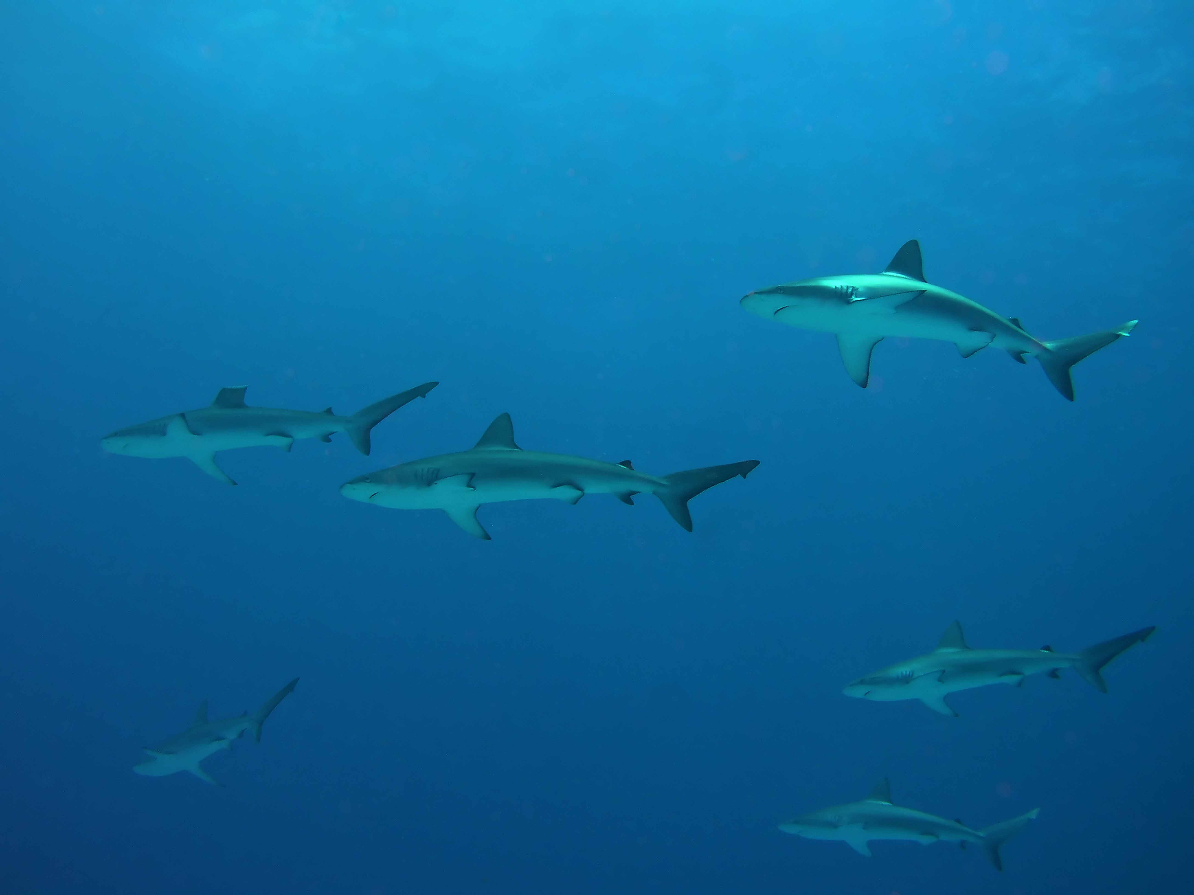

Meta-analysis of reef fish data in Hawaii to examine natural and anthropogenic processes
Alan Friedlander¹, Mary Donovan¹,
Kosta Stamoulis¹, Ivor Williams²,
¹Fisheries Ecology Research Lab, Univ. Hawaii
²CRED, PIFSC, NOAA

Slide 2
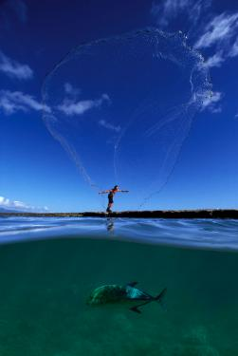
Outline & Products
Data collection and breadth
Length-weight relationships
  Spatial and temporal comparison
Bio-regionalization
  Assemblage structure
  Endemism
Human Impacts
  Gradients
  Spatial analysis
Modeling drivers
  Comparison of methods
  Modeling fish assemblages across biogeographic & anthropogenic gradients

Slide 3
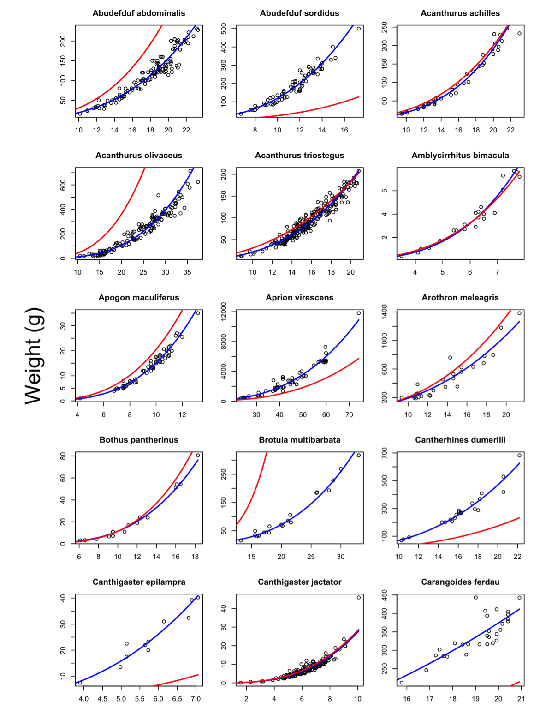
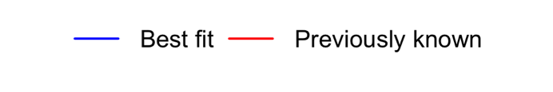
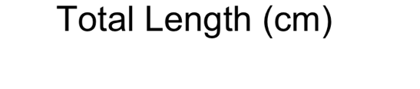
Length-weight Parameters for Hawaiian Reef Fishes
Published for the first time
112 species total
  33 Hawaiian Endemics
Subset Species used in temporal and regional comparisons
Large differences when compared to known values from other regions

Slide 4
Fish Survey Datasets
Program | Contributor | Year range | Geographic coverage | Method | N
NOAA RAMP CRED | Williams | 2000-2012 | NWHI and MHI | Belt < 2008, SPC 2008 | 7845
TNC | Conklin | 2008-2012 | Statewide | Belt | 814
DAR - Kona | Walsh | 1999-2012 | West Hawaii | Belt | 10240
DAR - Maui | Sparks |  | Maui | Belt
DAR - Oahu | Schumacher |  | Oahu | Belt
National Park Service | Brown, Friedlander, Beets | 2008-2012 | Kalaupapa, Kaloko, Honaunau, Puukohola | Belt | 501
FHUS (NOAA Biogeography) | Friedlander, Brown, | 2000-2004 | 12 MLCDs & adjacent areas statewide | Belt | 2021
FHUS (NOAA Biogeography) | Friedlander, Wedding | 2004-08 | Pupukea, Honolua, Kealakekua, Hanauma | Belt
FERL | Friedlander | 1992-2012 | Hanalei | Belt | 120
FERL | Friedlander | 2010, 2012 | Oahu, Lanai, Kauai | Belt | 542
CRAMP | Rodgers, Brown, Friedlander | 1998-2012 | Statewide | Belt | 380
 |  |  |  | TOTAL | 22463
Notes:
11 datasets

Slide 5
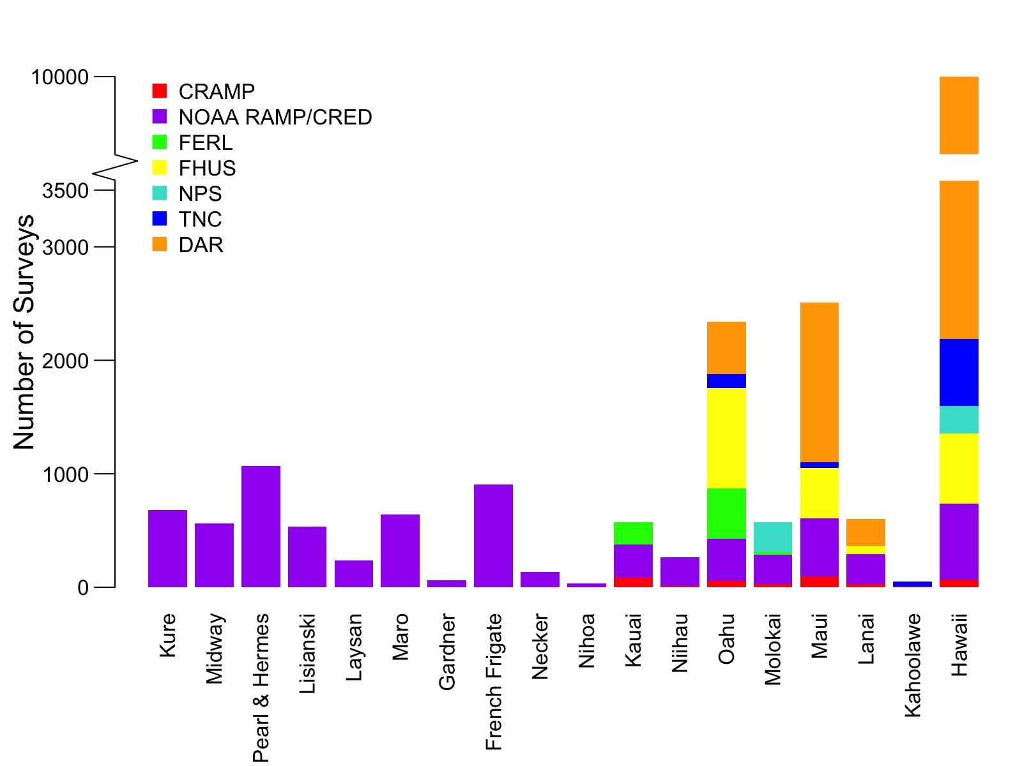
Number of fish surveys by Island
Notes:
Actual DAR Hawaii is 8138

Slide 6
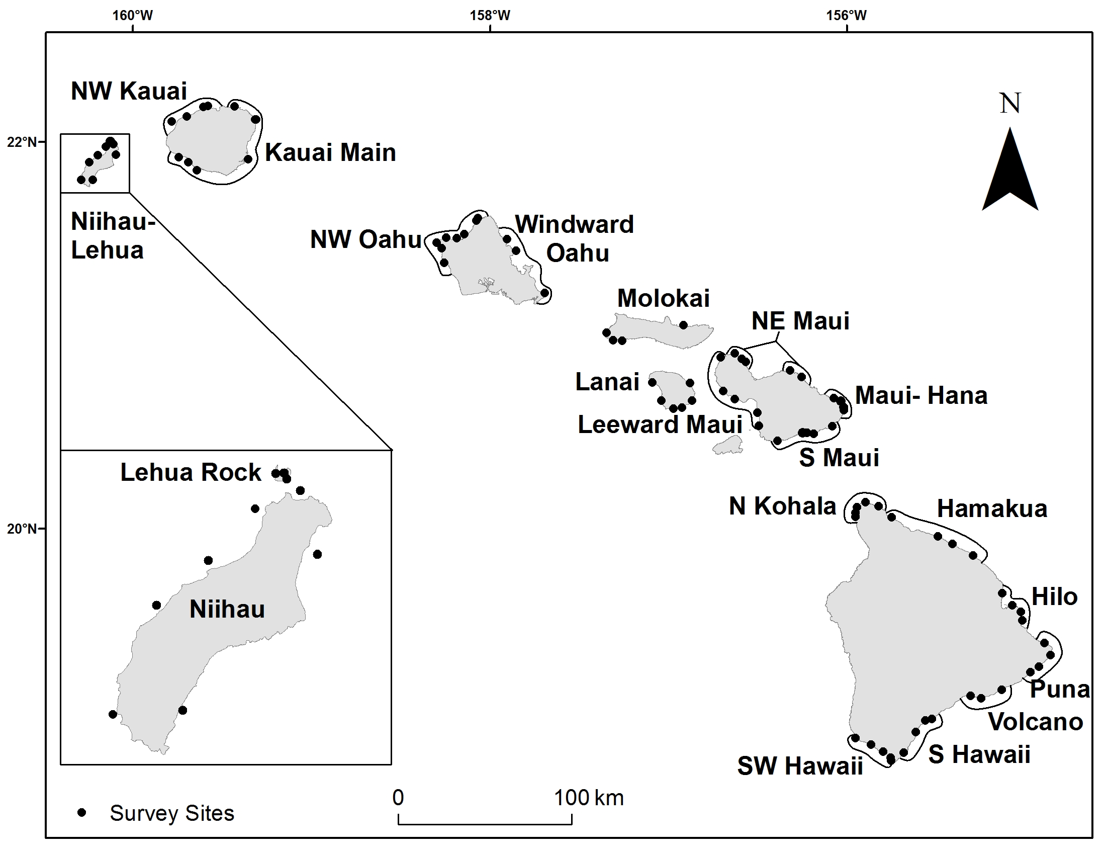
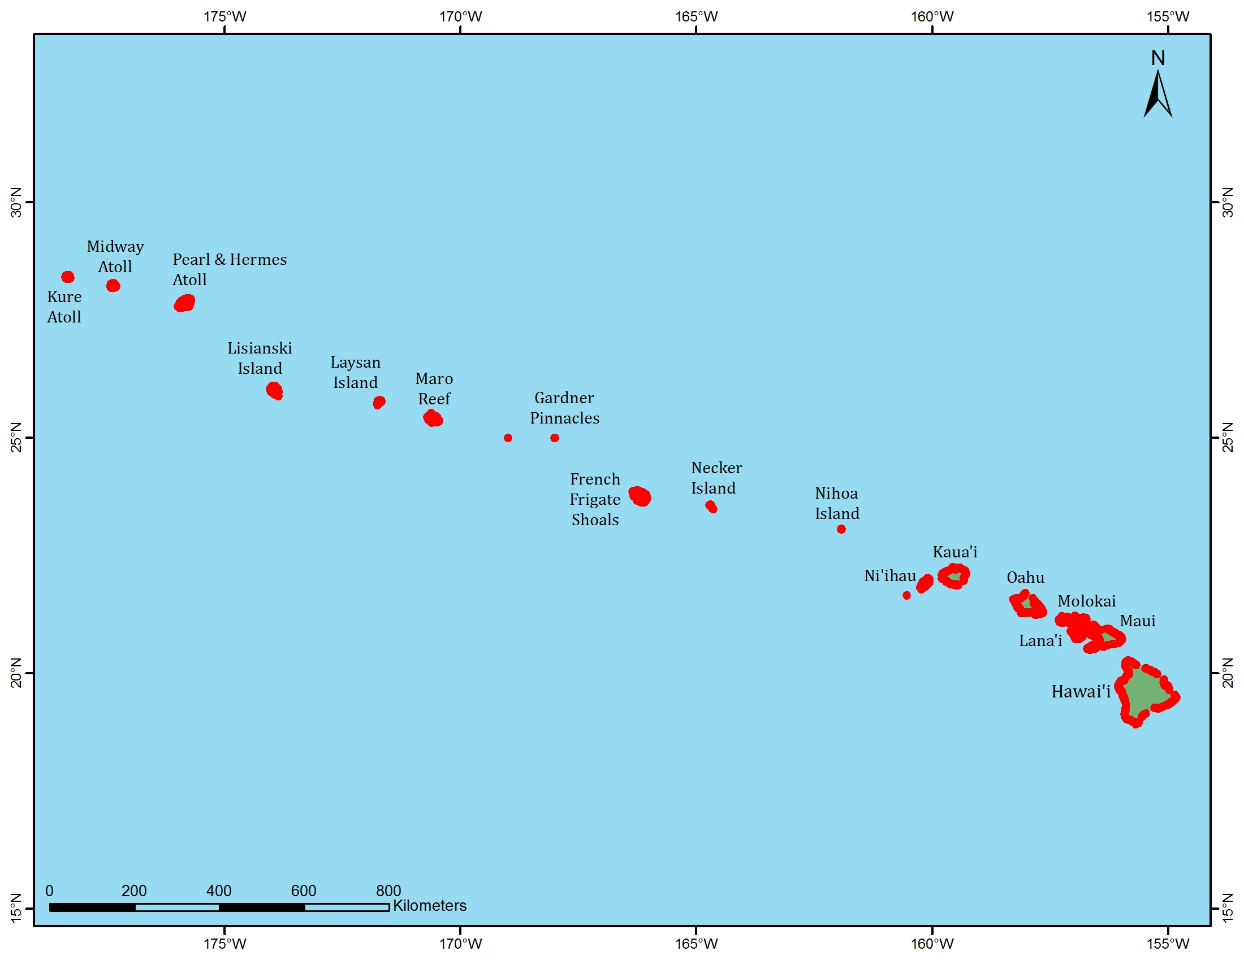
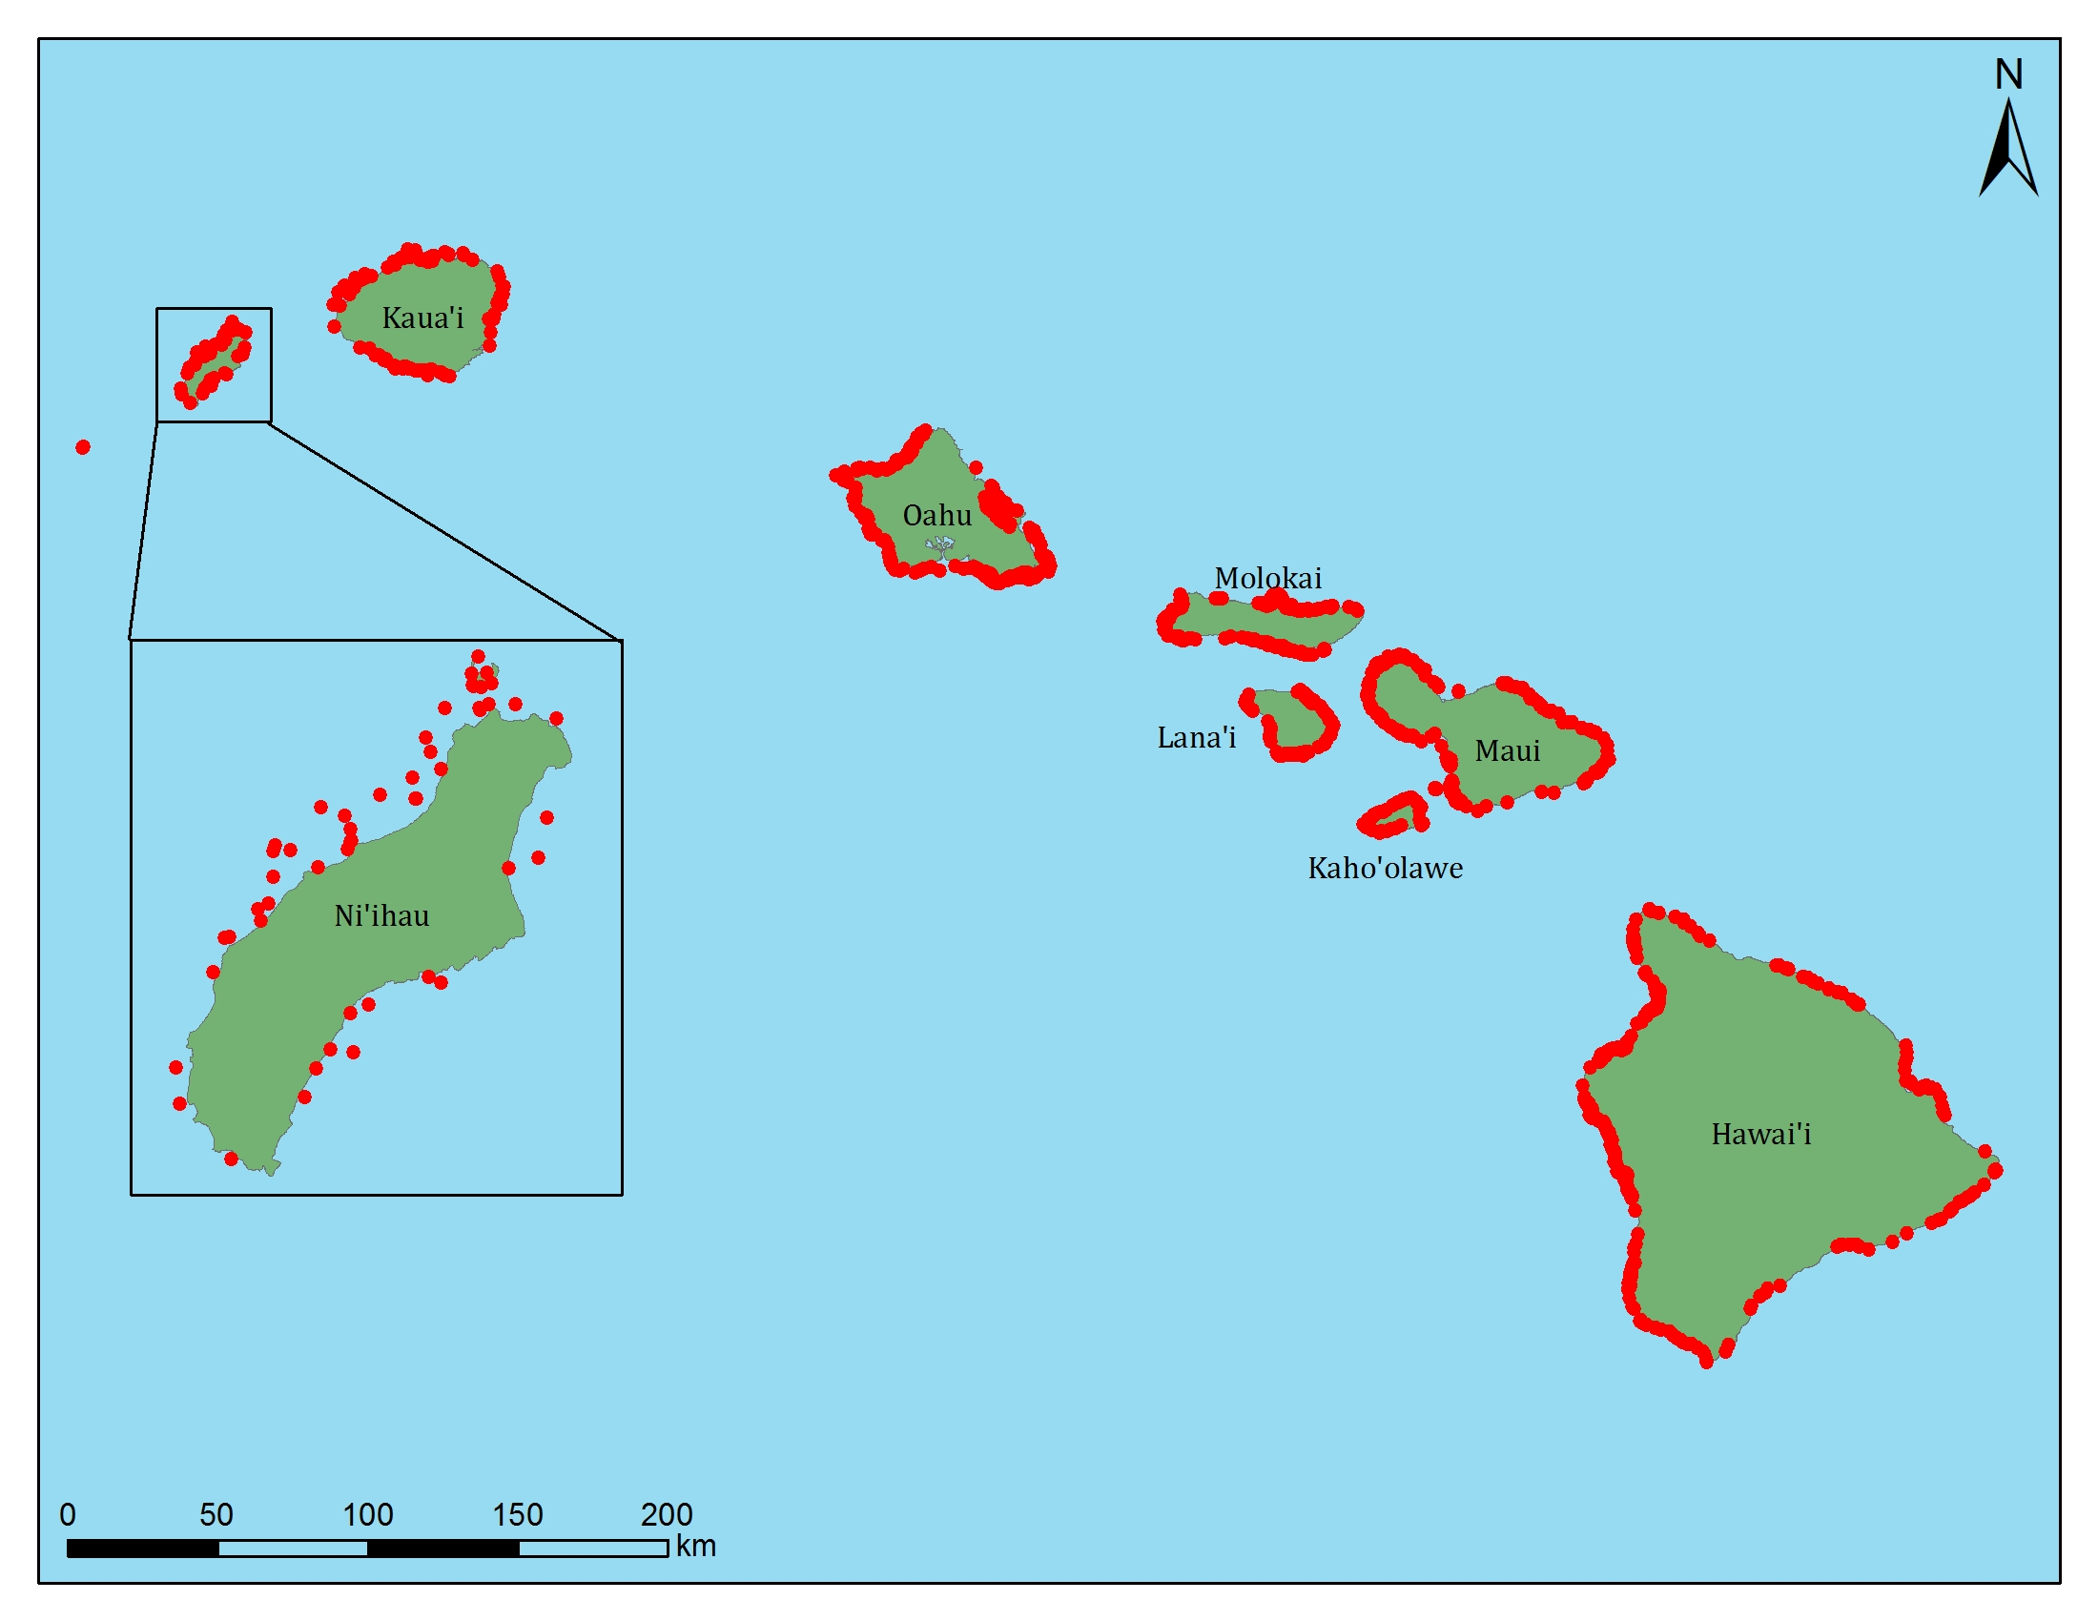
Archipelago-level survey effort
Williams et al. 2008
565
1070
678
535
644
60
239
133
32
571
2340
908
2508
266
This Study
600
575
52
10327
Notes:
Our map should be updated…

Slide 7
Biogregionalization
  Assemblages vary between NWHI and MHI
  Species composition varies along latitudinal gradient
  Related to geographic extent of species distributions
  Latitudinal correlations exist for a variety of species
  Higher level of endemism in NWHI

Slide 8
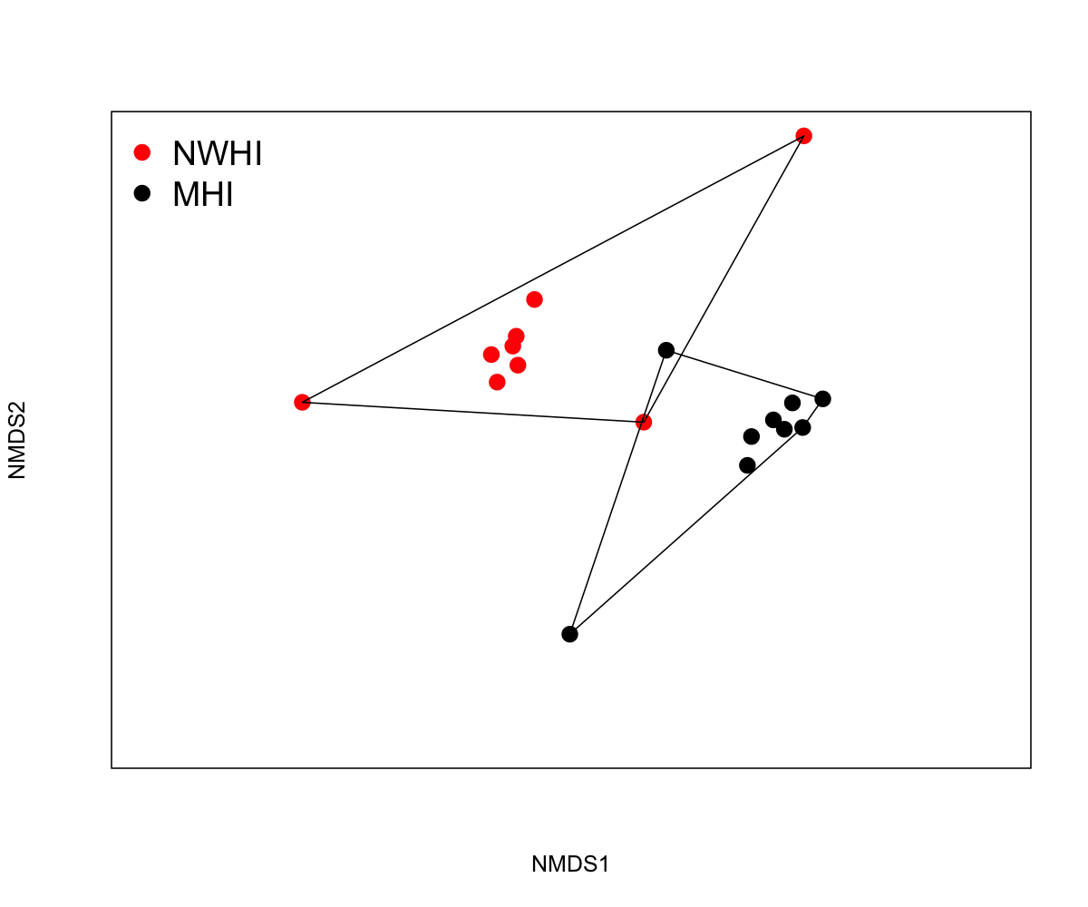
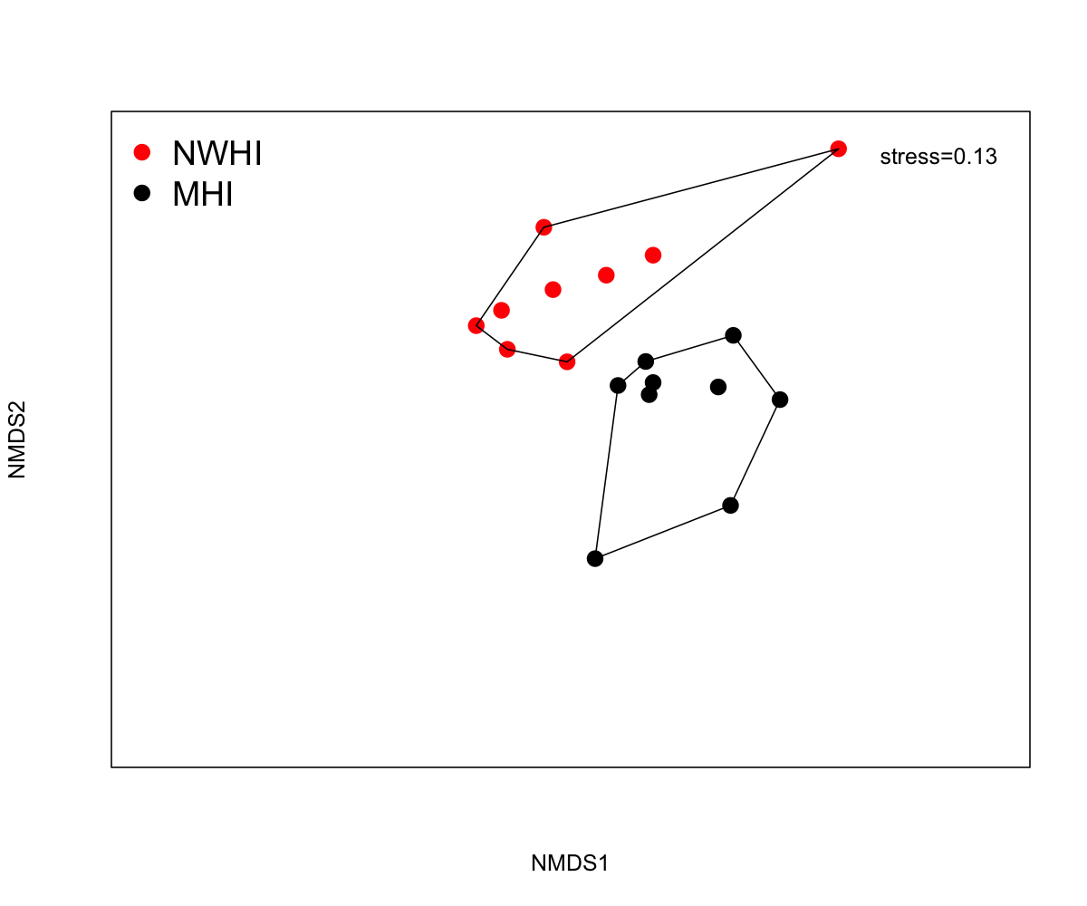
Multidimensional examination of fish species assemblages
Assemblages distinct between MHI & NWHI
Higher concordance using biomass
Biomass
Abundance
Nihoa
Nihoa
Lisianski
Laysan
Necker
Kure
Kure
Midway
Niihau
Maro
Niihau
Lisianski
Midway
Kauai
Necker
P&H
Maui
P&H
FFS
FFS
Hawaii
Oahu
Oahu
Hawaii
Molokai
Maro
Laysan
Kauai
Maui
Lanai
Kahoolawe
Kahoolawe
Lanai
Molokai
Stress = 0.09
Stress = 0.013
ANOSIM R: 0.57, p < 0.01
ANOSIM R: 0.47, p < 0.01
Notes:
MDS Ordinations based on entire species assemblages.

Slide 9
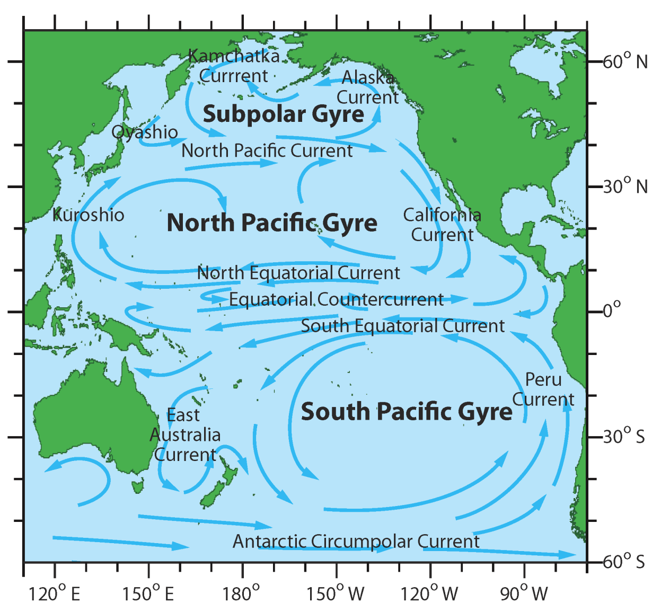
Measuring species’ range size
EOO = Extent of Occurrence
The area encompassed by the minimum convex polygon of occurrence
EOO = Extent of Occurrence
Notes:
These data were complied by an international working group lead by Micheal Kulbicki based on checklists from169 locations around the globe.

Slide 10
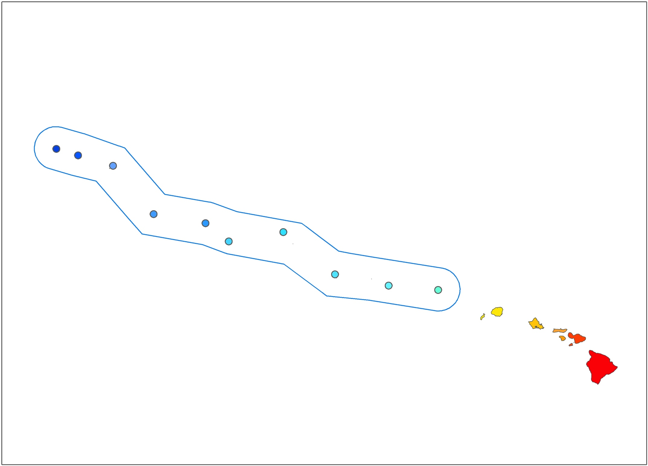
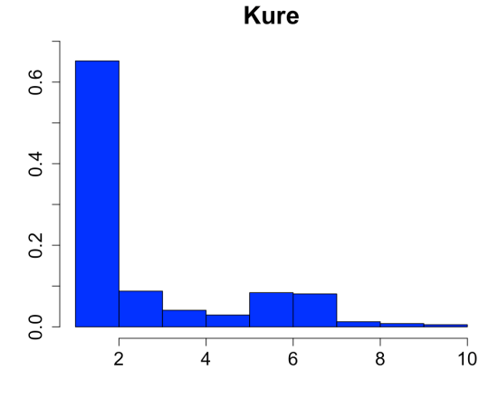
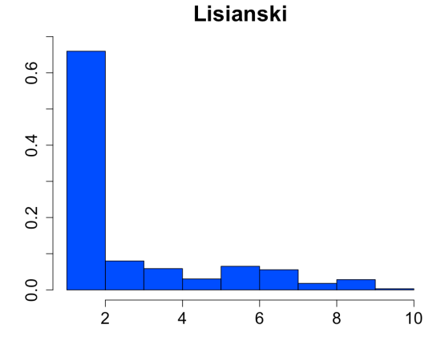
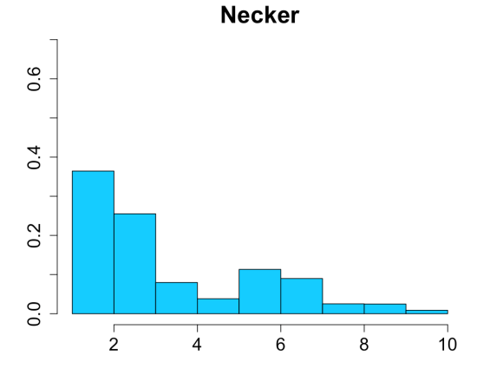
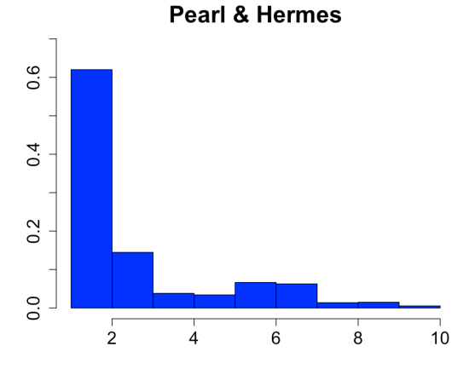
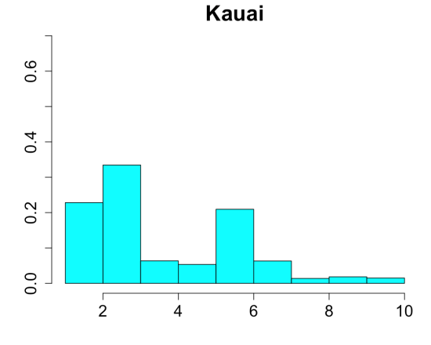
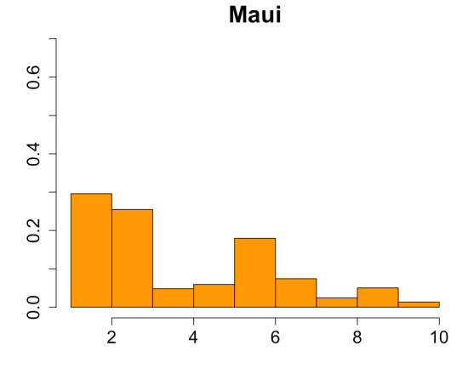
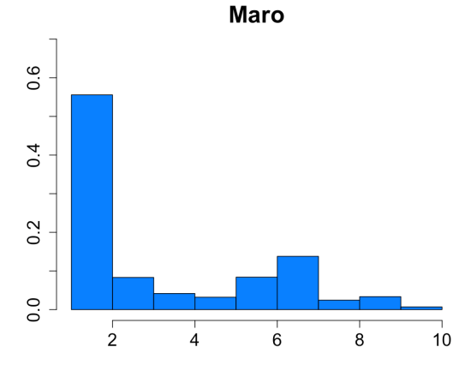
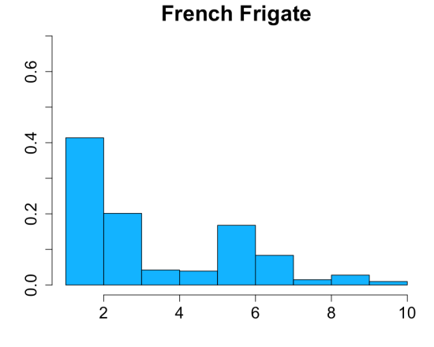
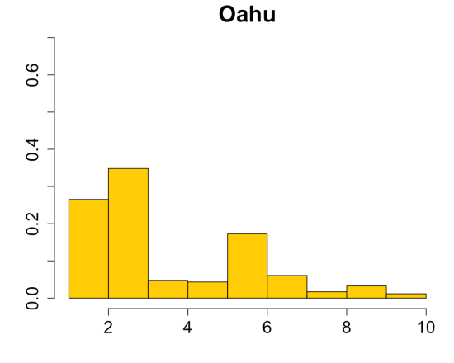
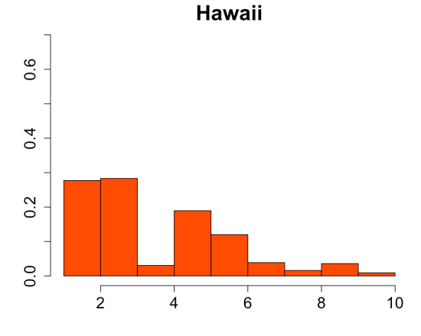
Gradient of range size with Latitude
Prop of Density
EOO (km²)

Slide 11
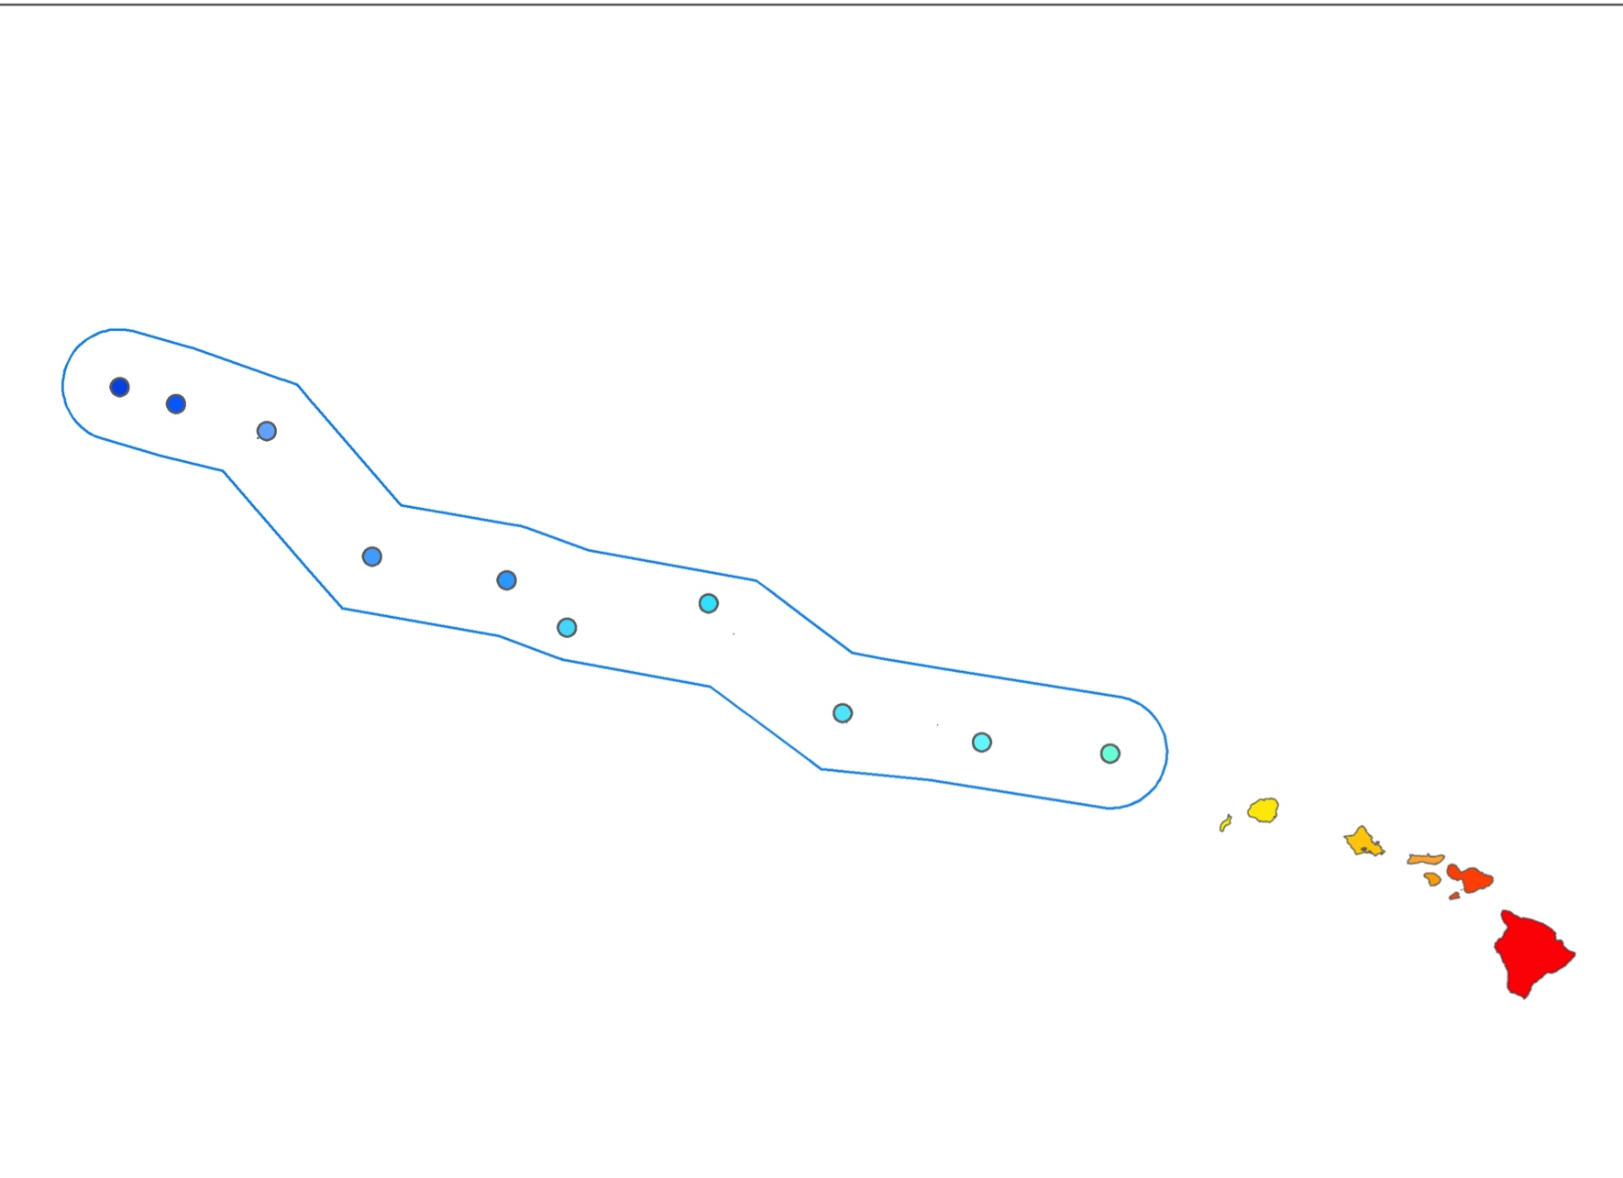
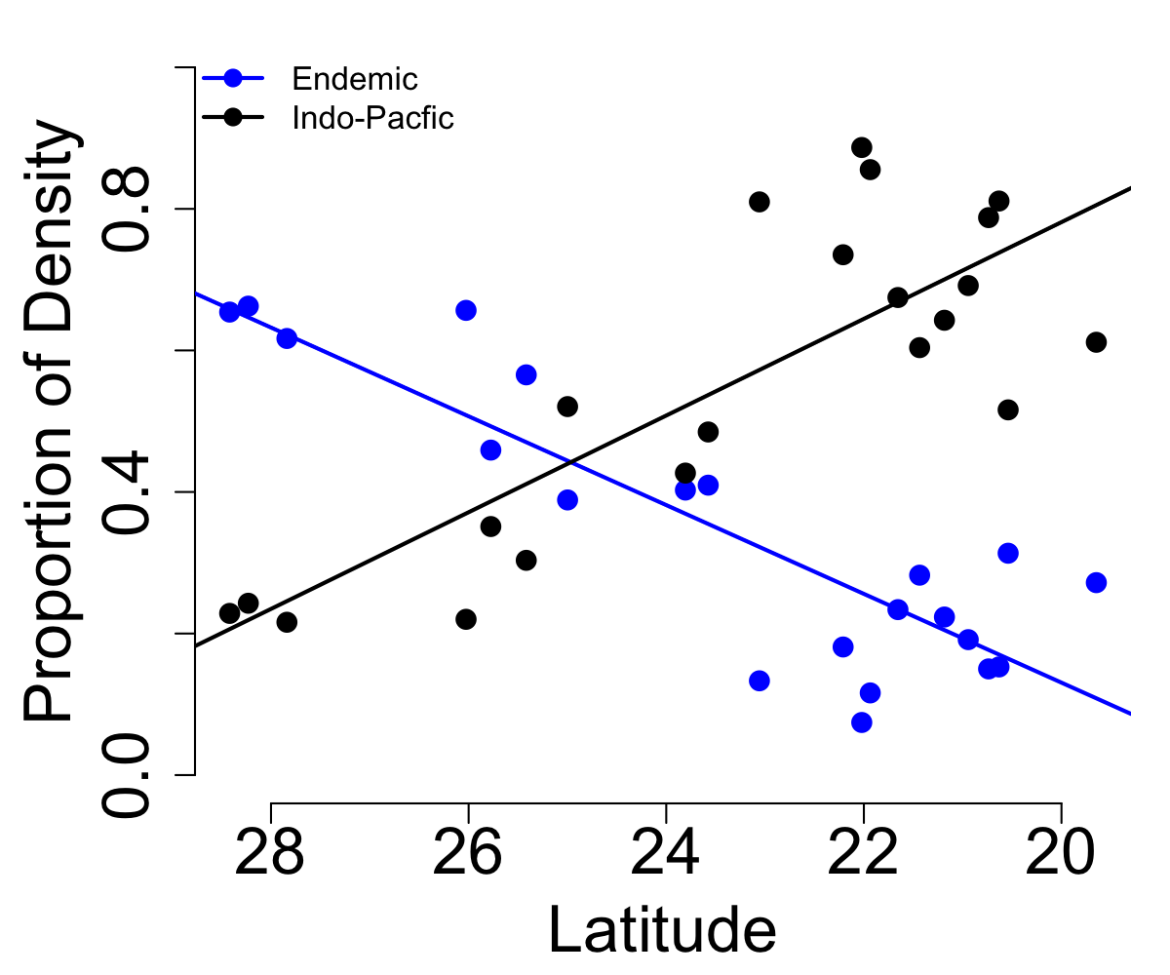
Zoogeography with Latitude
Notes:
24.96643 degress

Slide 12
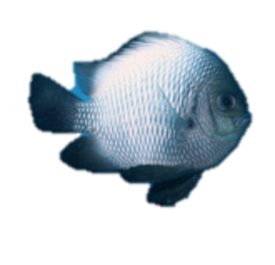
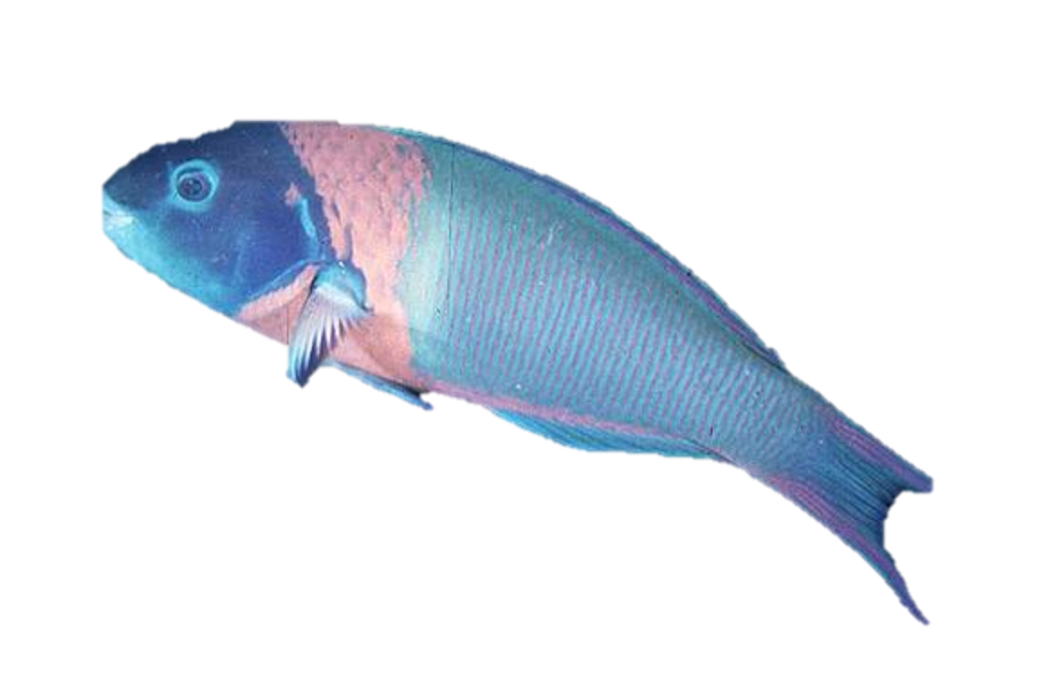
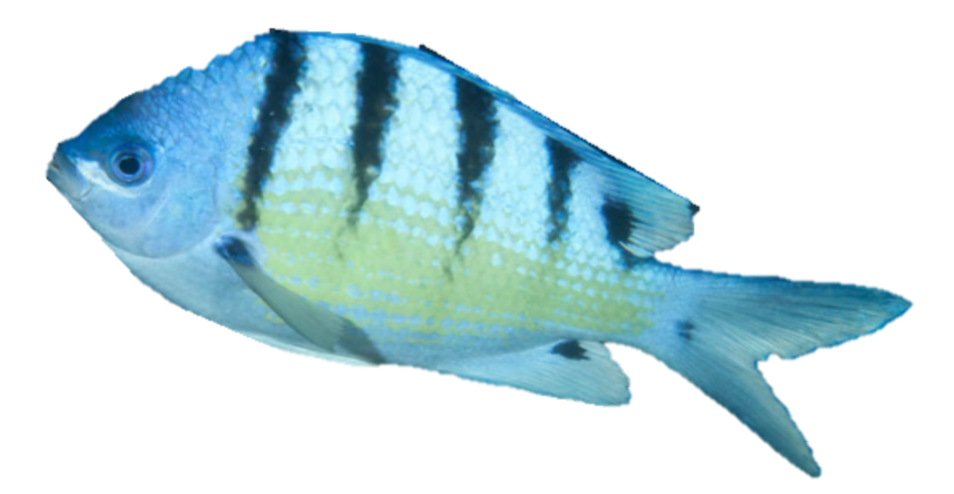
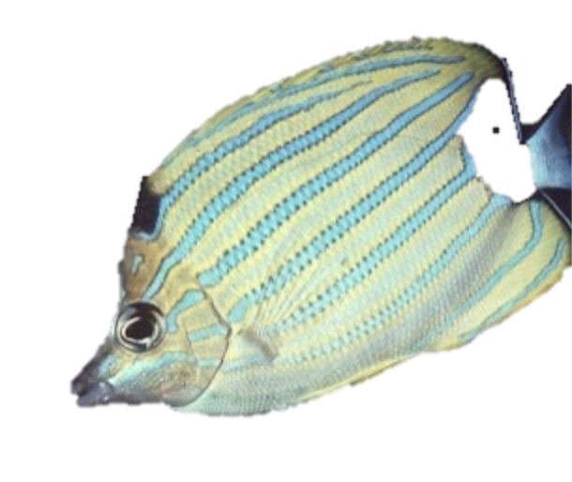
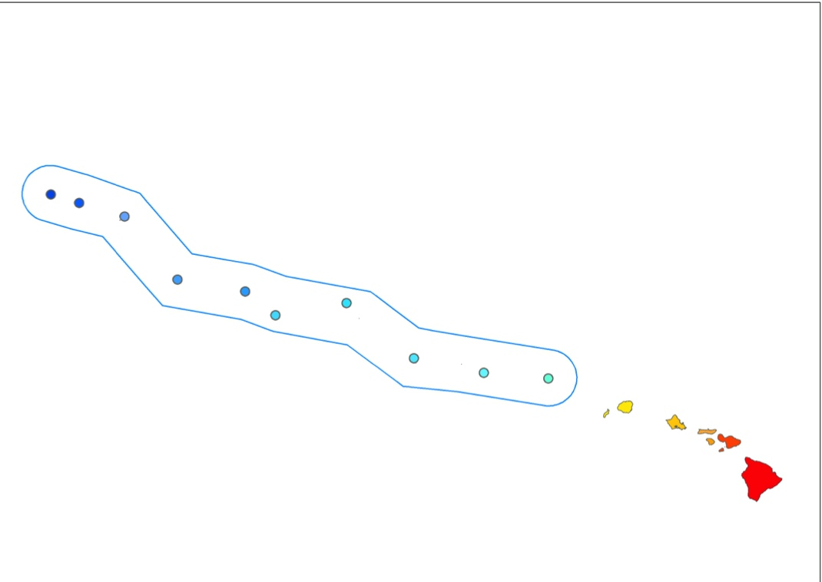
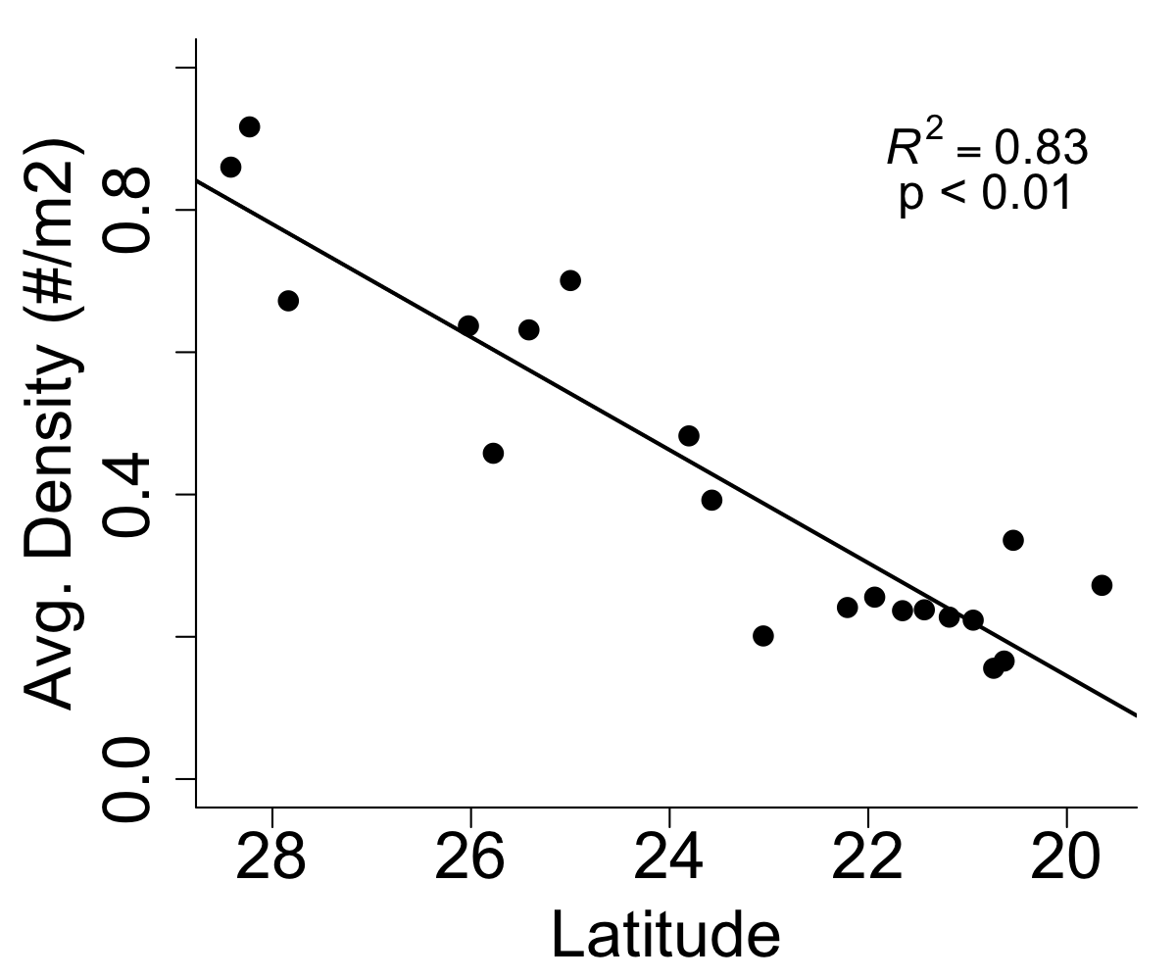
Endemic species
25% species endemic to Hawaii
Numerical endemism is 50% in NWHI compared to 20% in MHI
Higher endemism at the N end of chain

Slide 13
Human Impacts
  Gradient of fish biomass within the MHI
  Large difference in total biomass comparing NWHI and MHI
  Fish assemblages have high concordance with traditional Hawaiian management systems
  Comparison of MPAs across MHI

Slide 14
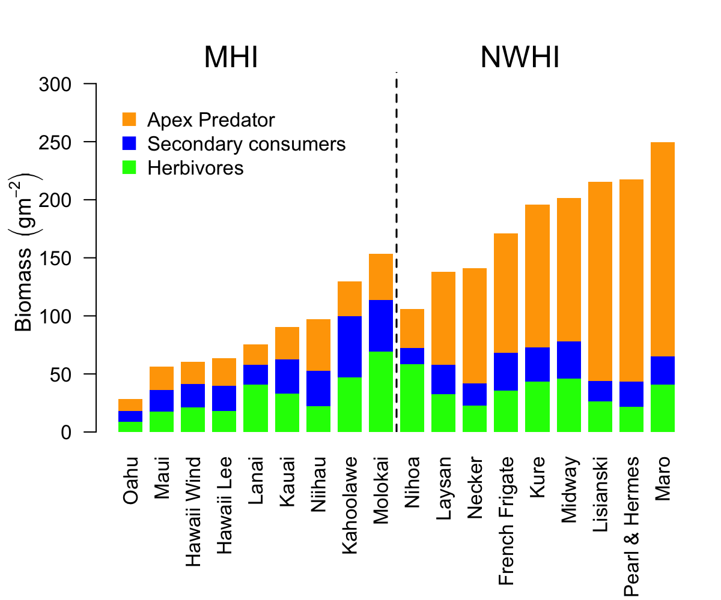

Slide 15
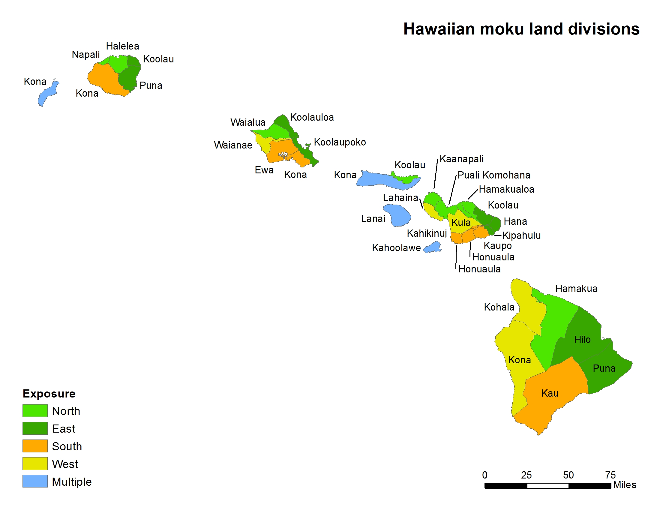
Data Source: State of Hawaii

Slide 16
Boosted Regression Tree Analysis of Fish Biomass with large-scale Habitat Variables
Relative % variance explained

Slide 17
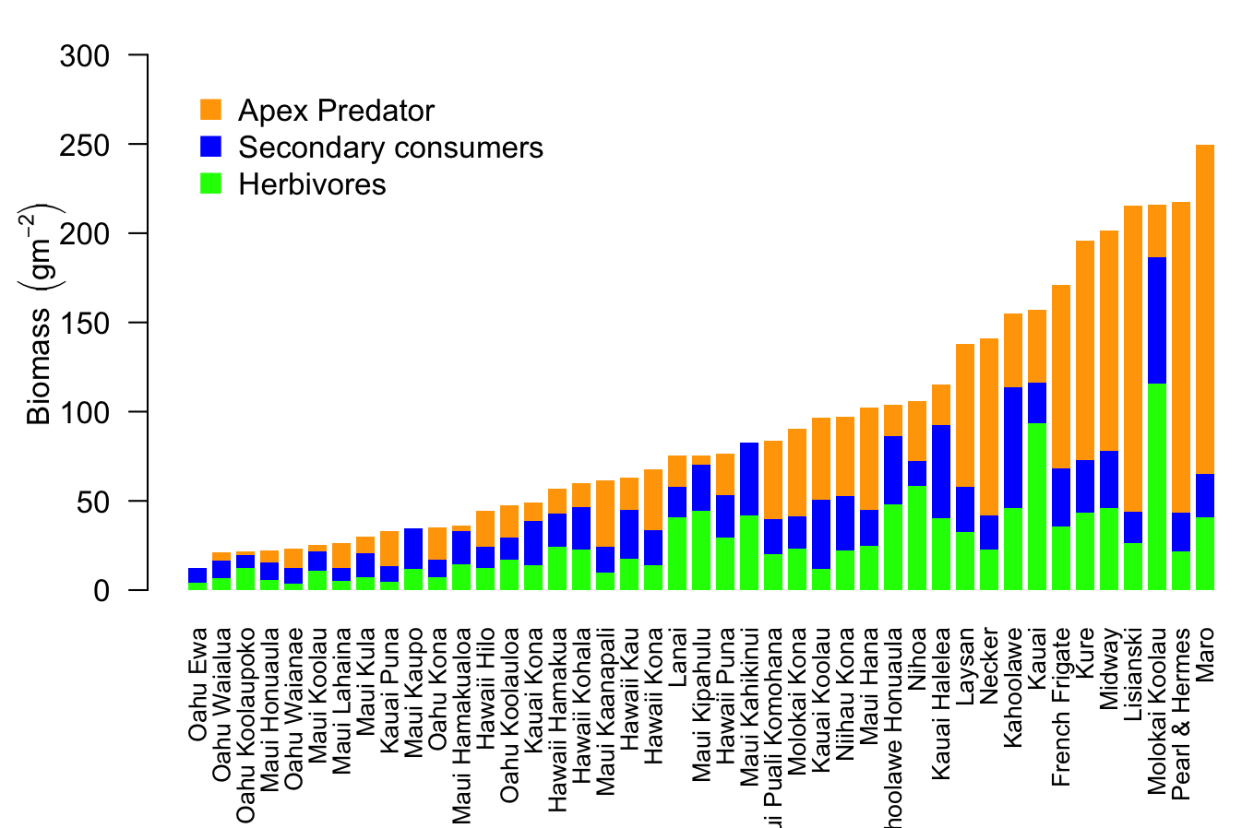
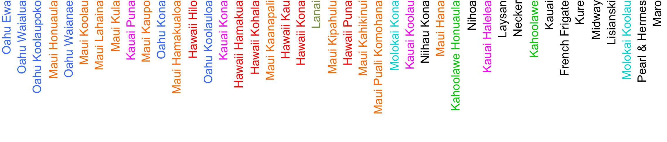
Fish Biomass Gradient by Moku and Island

Slide 18
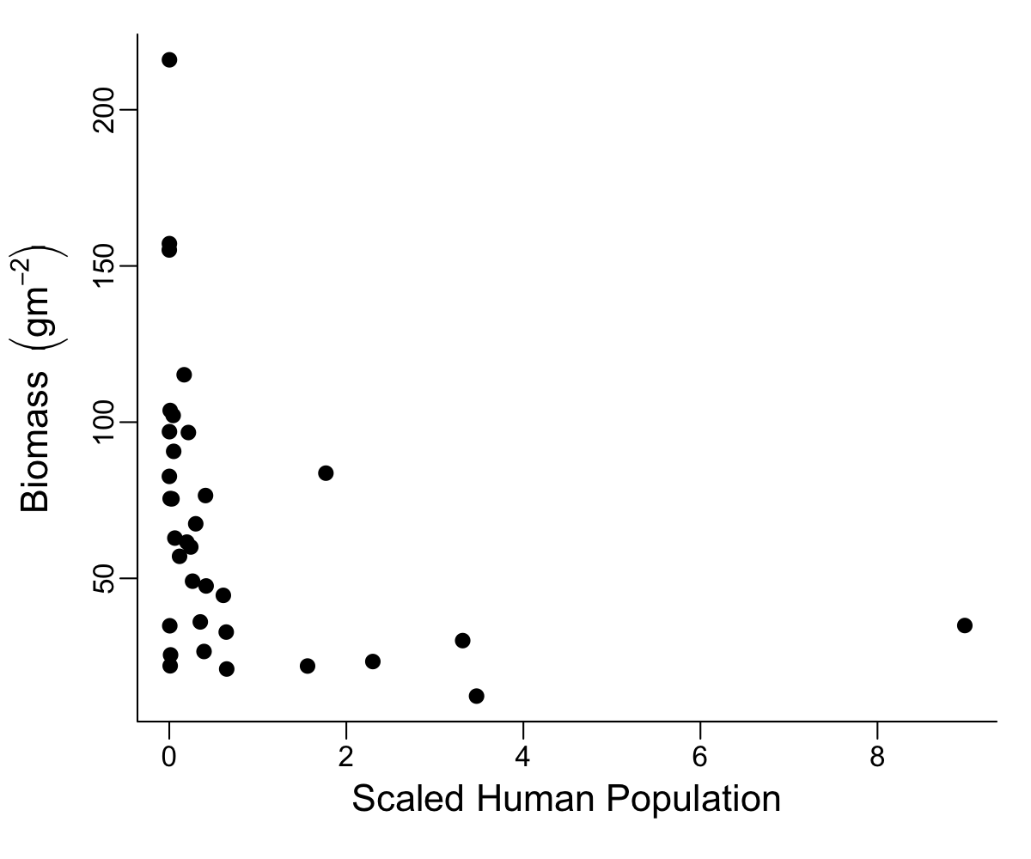
Fish Biomass and Human Population by Moku

Slide 19
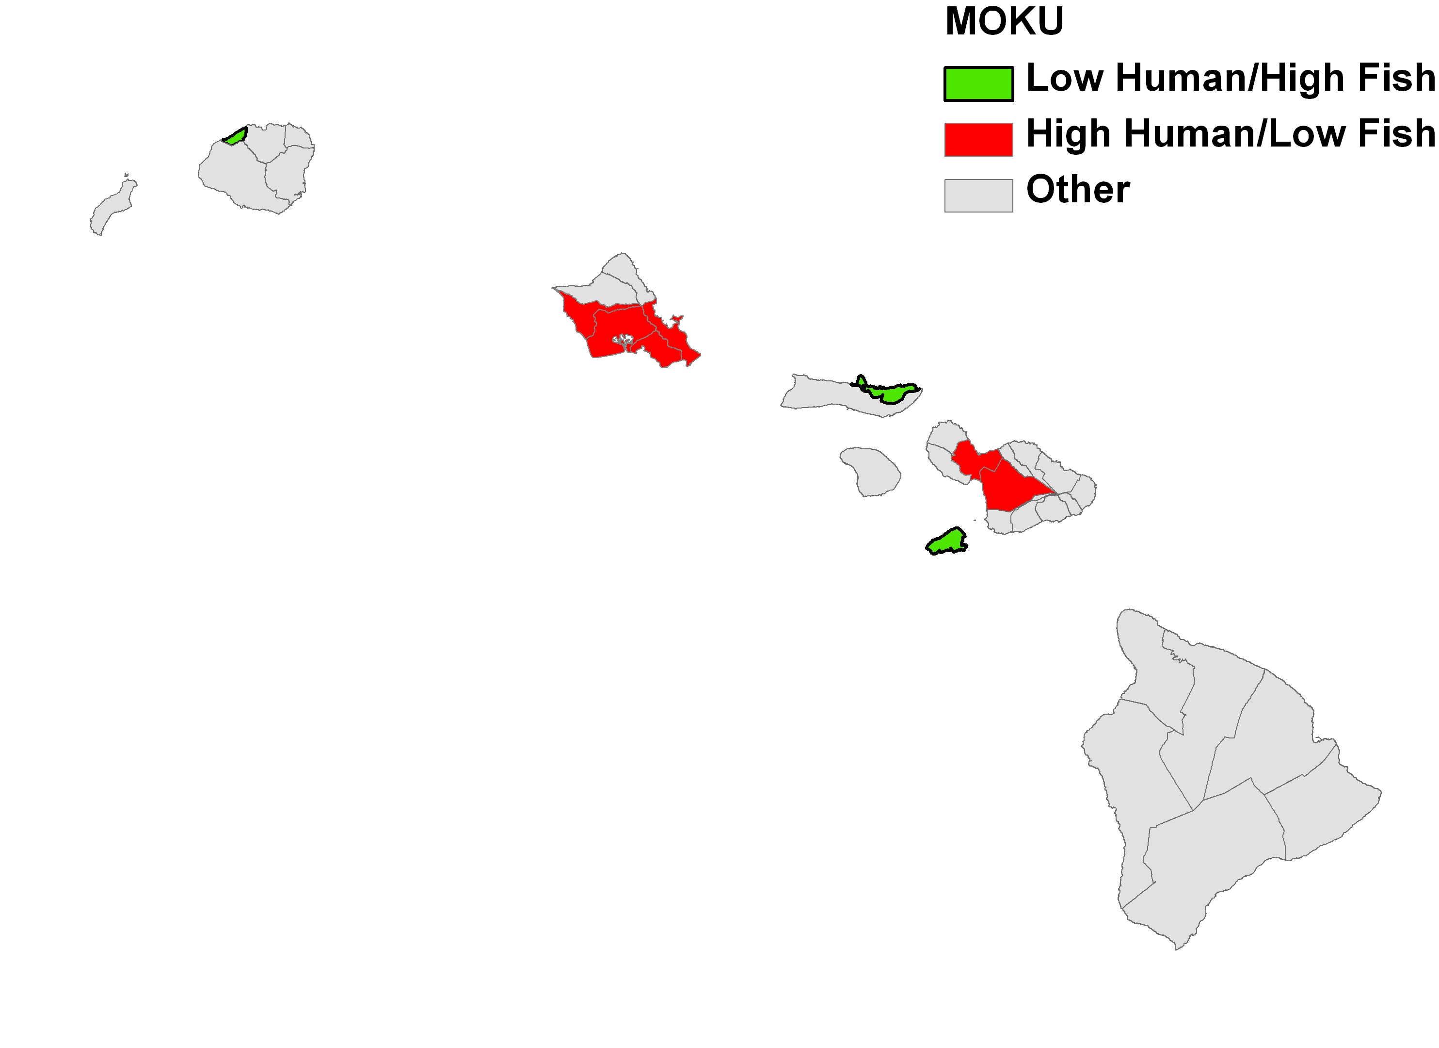
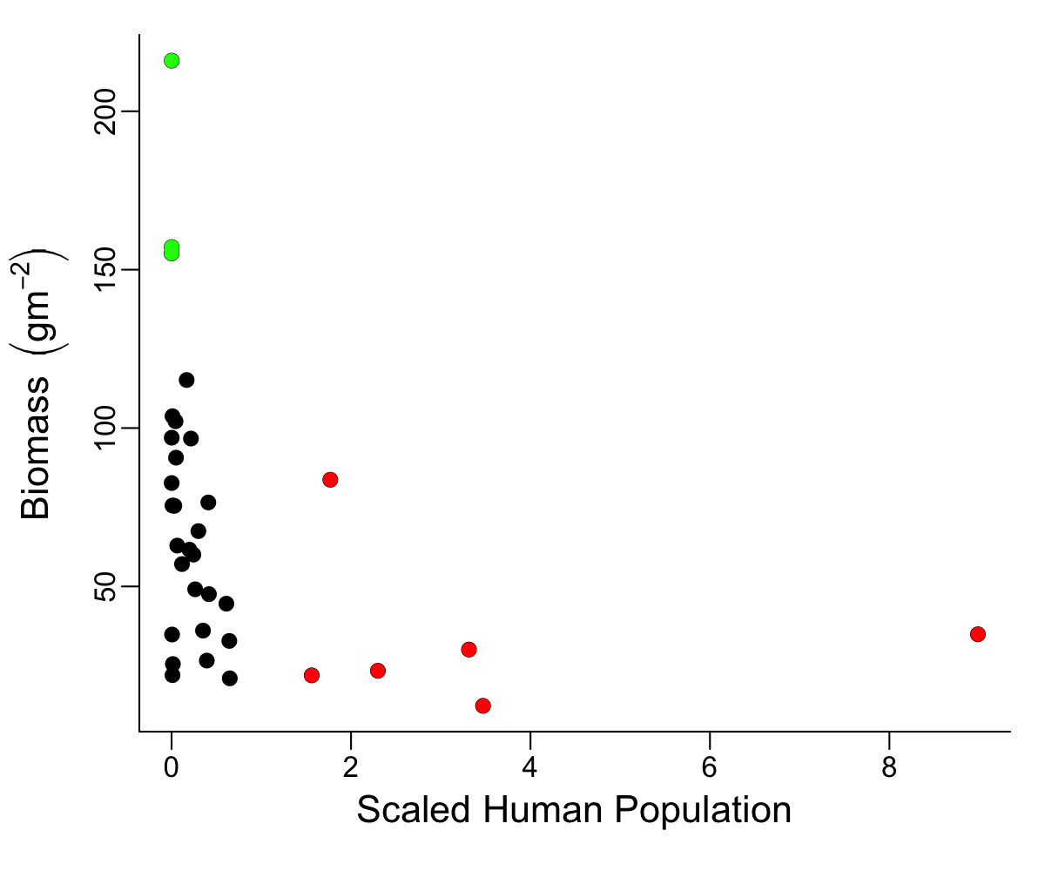
Kaho‘olawe
Ko‘olau (Moloka‘i)
Napali (Kaua‘i)
Pali Komohana (Maui)
Kona (O‘ahu)

Slide 20
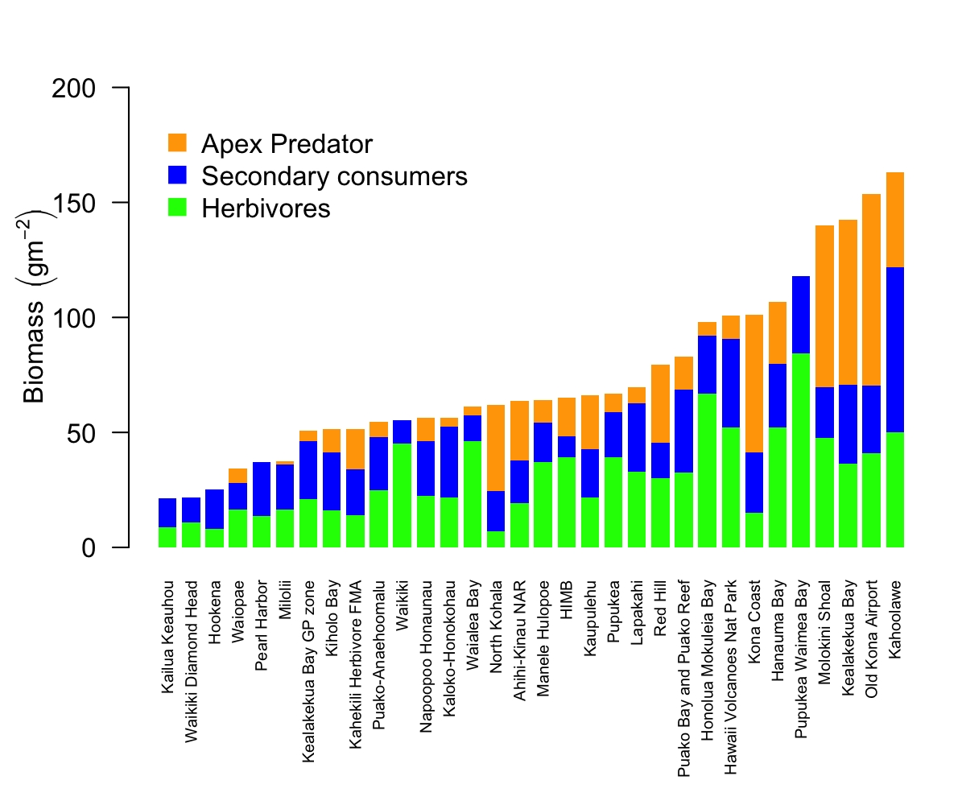
Fish biomass by Marine Protected area

Slide 21
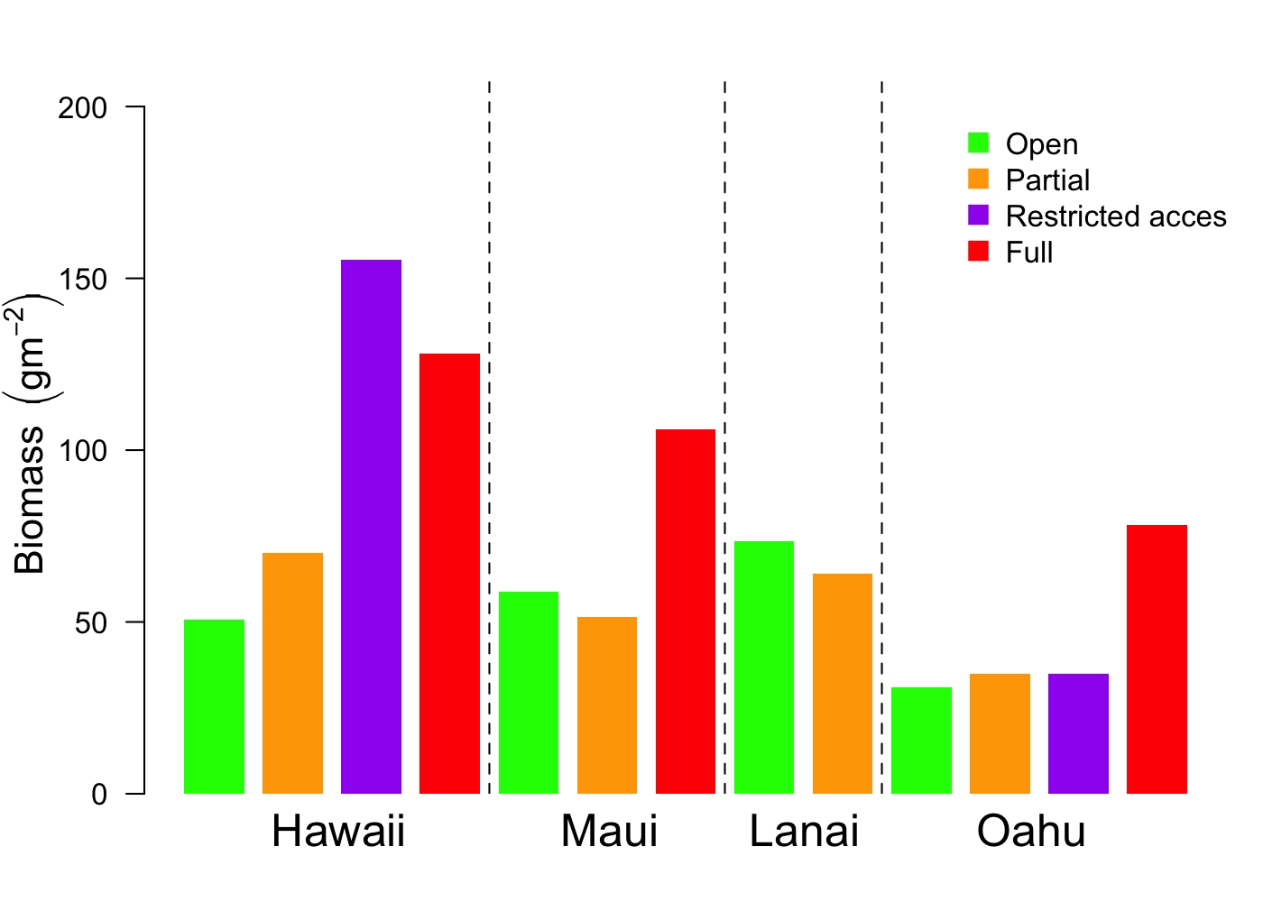
Comparison of fish biomass by protected status & island

Slide 22
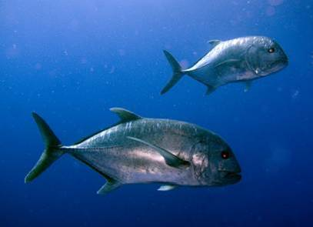
Mahalo
mdono@hawaii.edu

