Slide 1
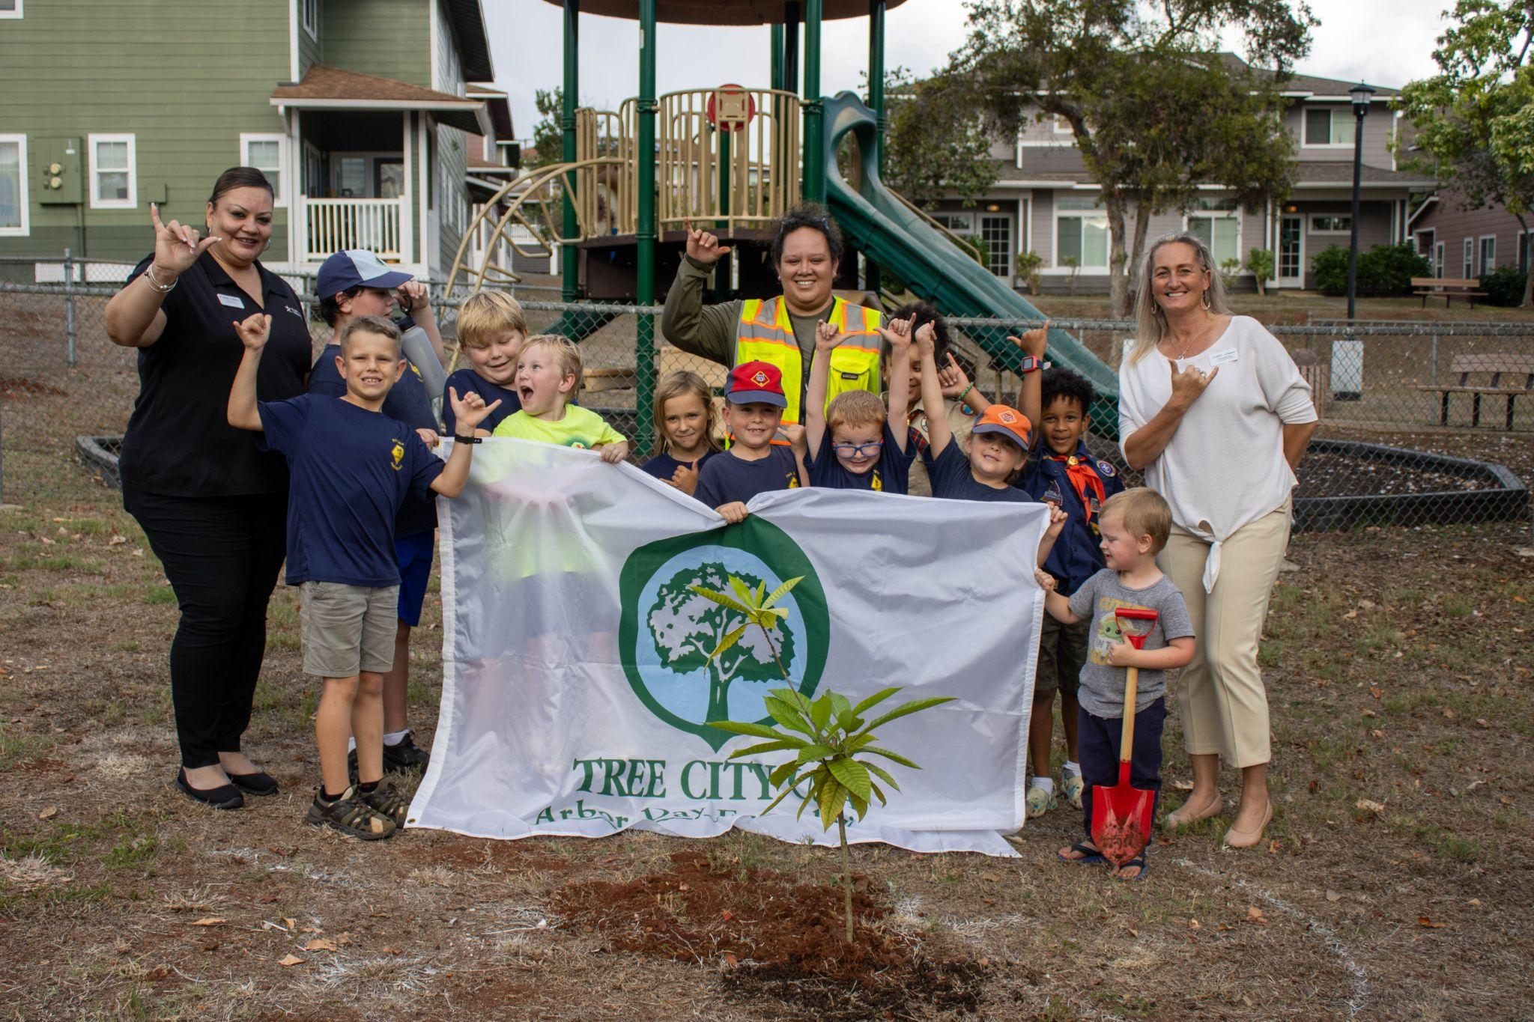
BECOMING A TREE CAMPUS
2023 Arbor Day celebration at Aliamanu Military Reservation.
Leʻa Kaʻahaʻaina, Communications & Outreach
Skye Haraga, Kupu ʻĀina Corps Member
Kaulunani Urban & Community Forestry
September 2024
Notes:
Kaulunani is proud to be the State of Hawaii’s Urban and Community Forestry Program housed within the Department of Land and Natural Resources’ (DLNR) Division of Forestry and Wildlife.
Visit the Kaulunani program website at www.kaulunani.org.

Slide 2
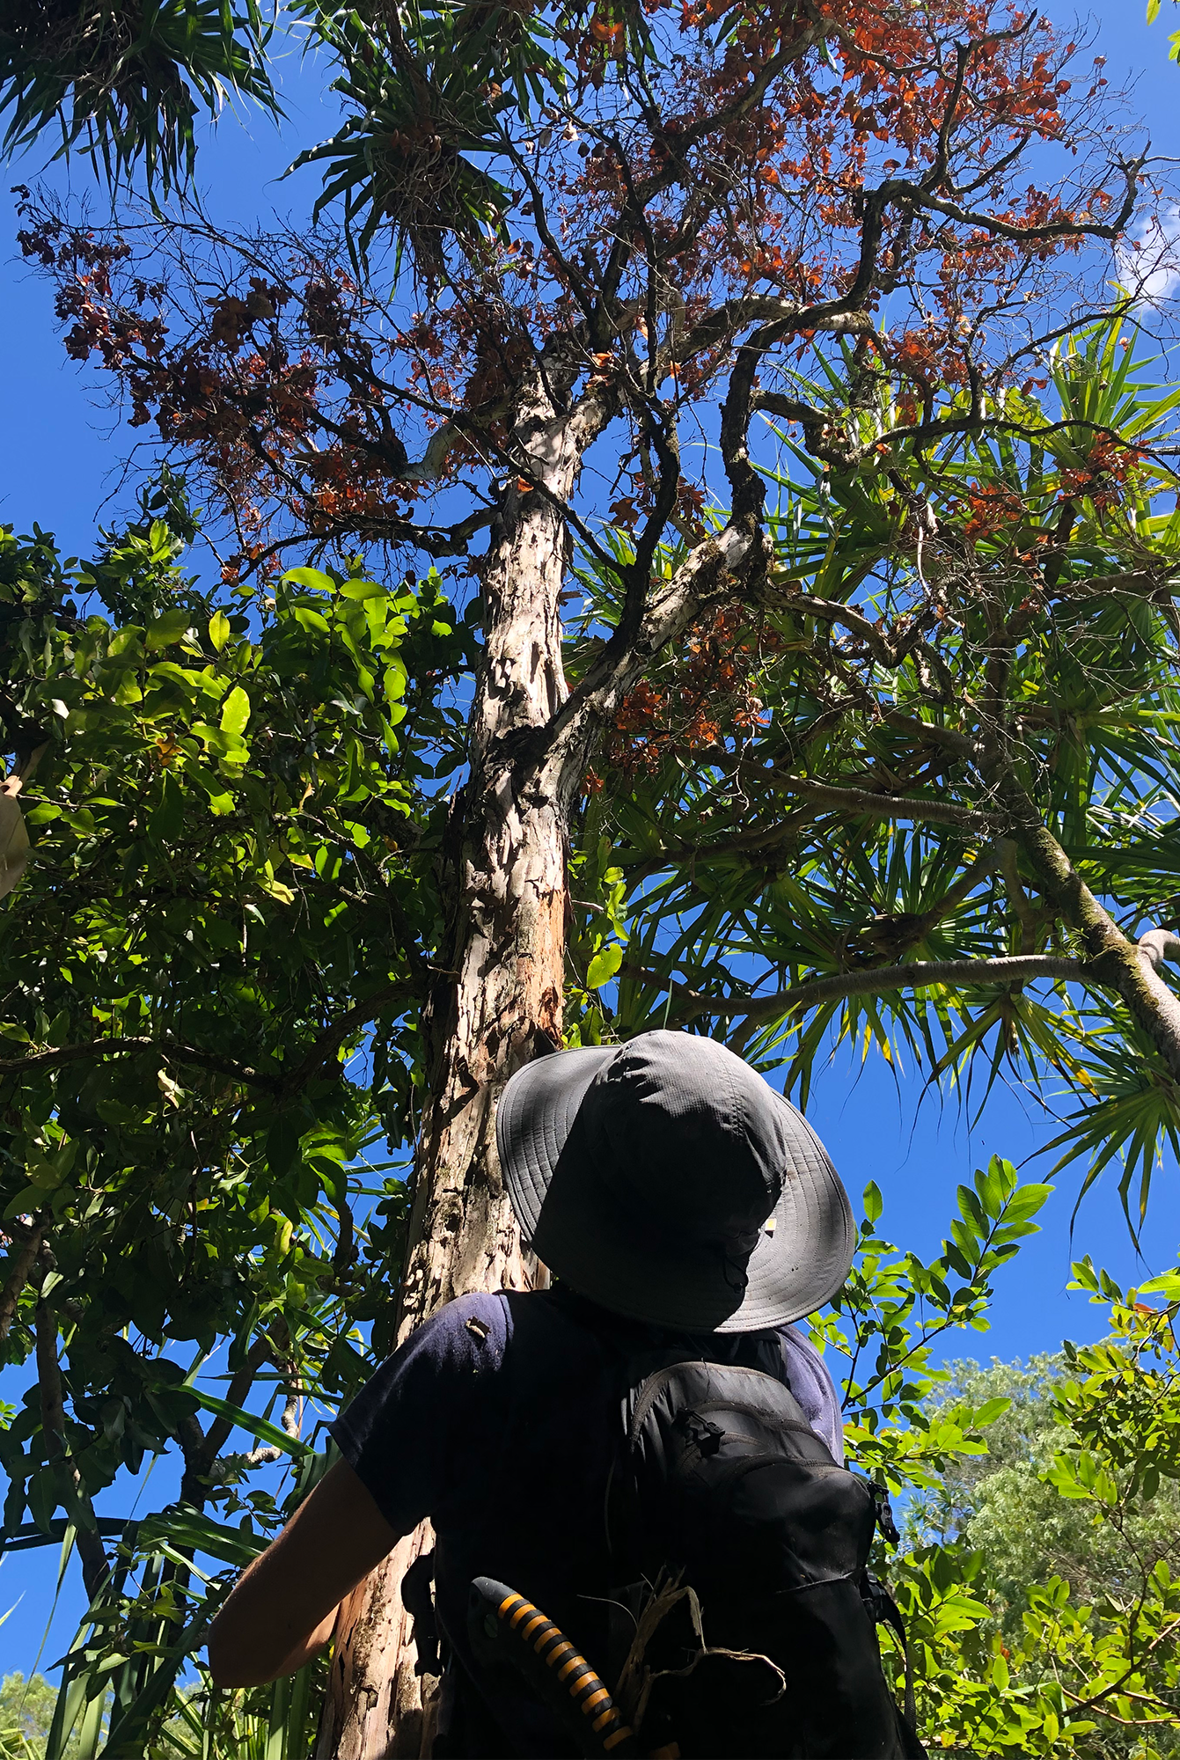
WHO WE ARE
MISSION
To support all of Hawaiʻi’s communities with a focus on equity to cultivate well-being and resilience through restorative & environmental justice, planting, caring for, and growing relationships with the trees and forests where we live, work, learn and play.
Notes:
Kaulunani is proud to be the State of Hawaii’s Urban and Community Forestry Program housed within the Department of Land and Natural Resources’ (DLNR) Division of Forestry and Wildlife.
Visit the Kaulunani program website at www.kaulunani.org.

Slide 3
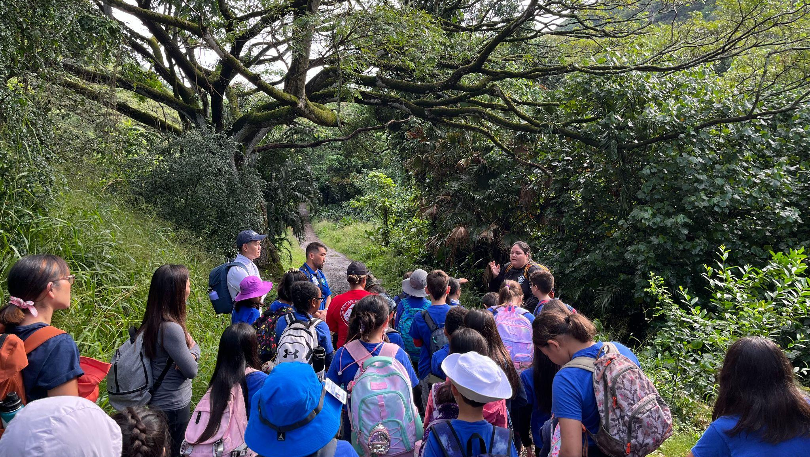
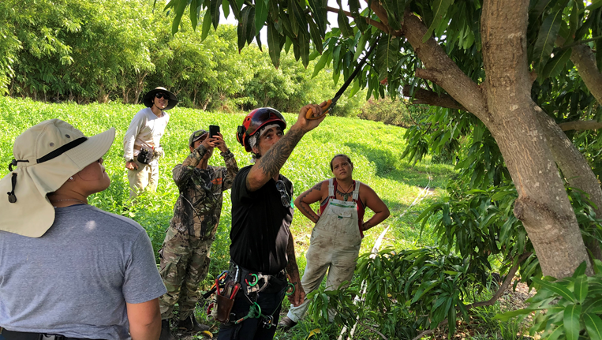
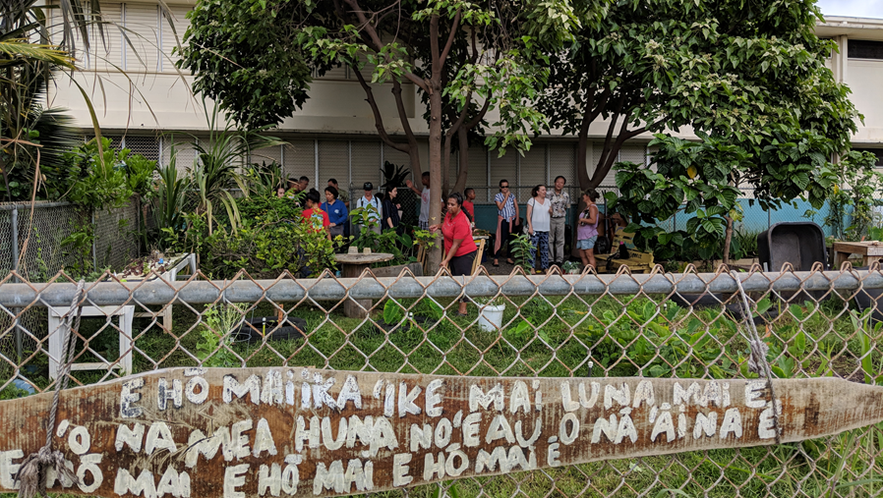
Trees where we live, work, learn, and play
Wao Kanaka
Notes:
Kaulunani is proud to be the State of Hawaii’s Urban and Community Forestry Program housed within the Department of Land and Natural Resources’ (DLNR) Division of Forestry and Wildlife.
Visit the Kaulunani program website at www.kaulunani.org.

Slide 4
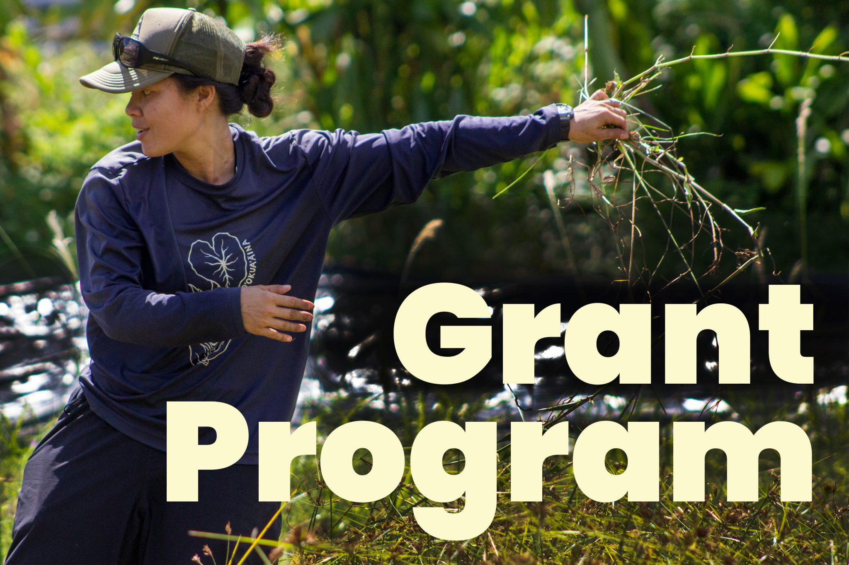
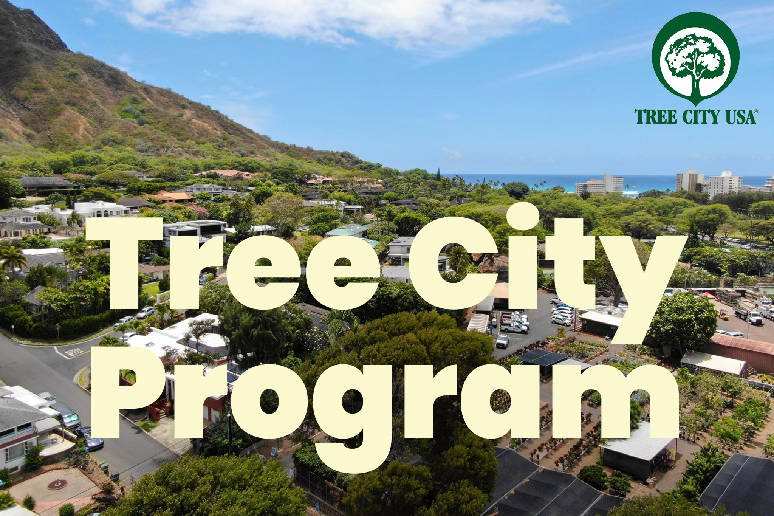
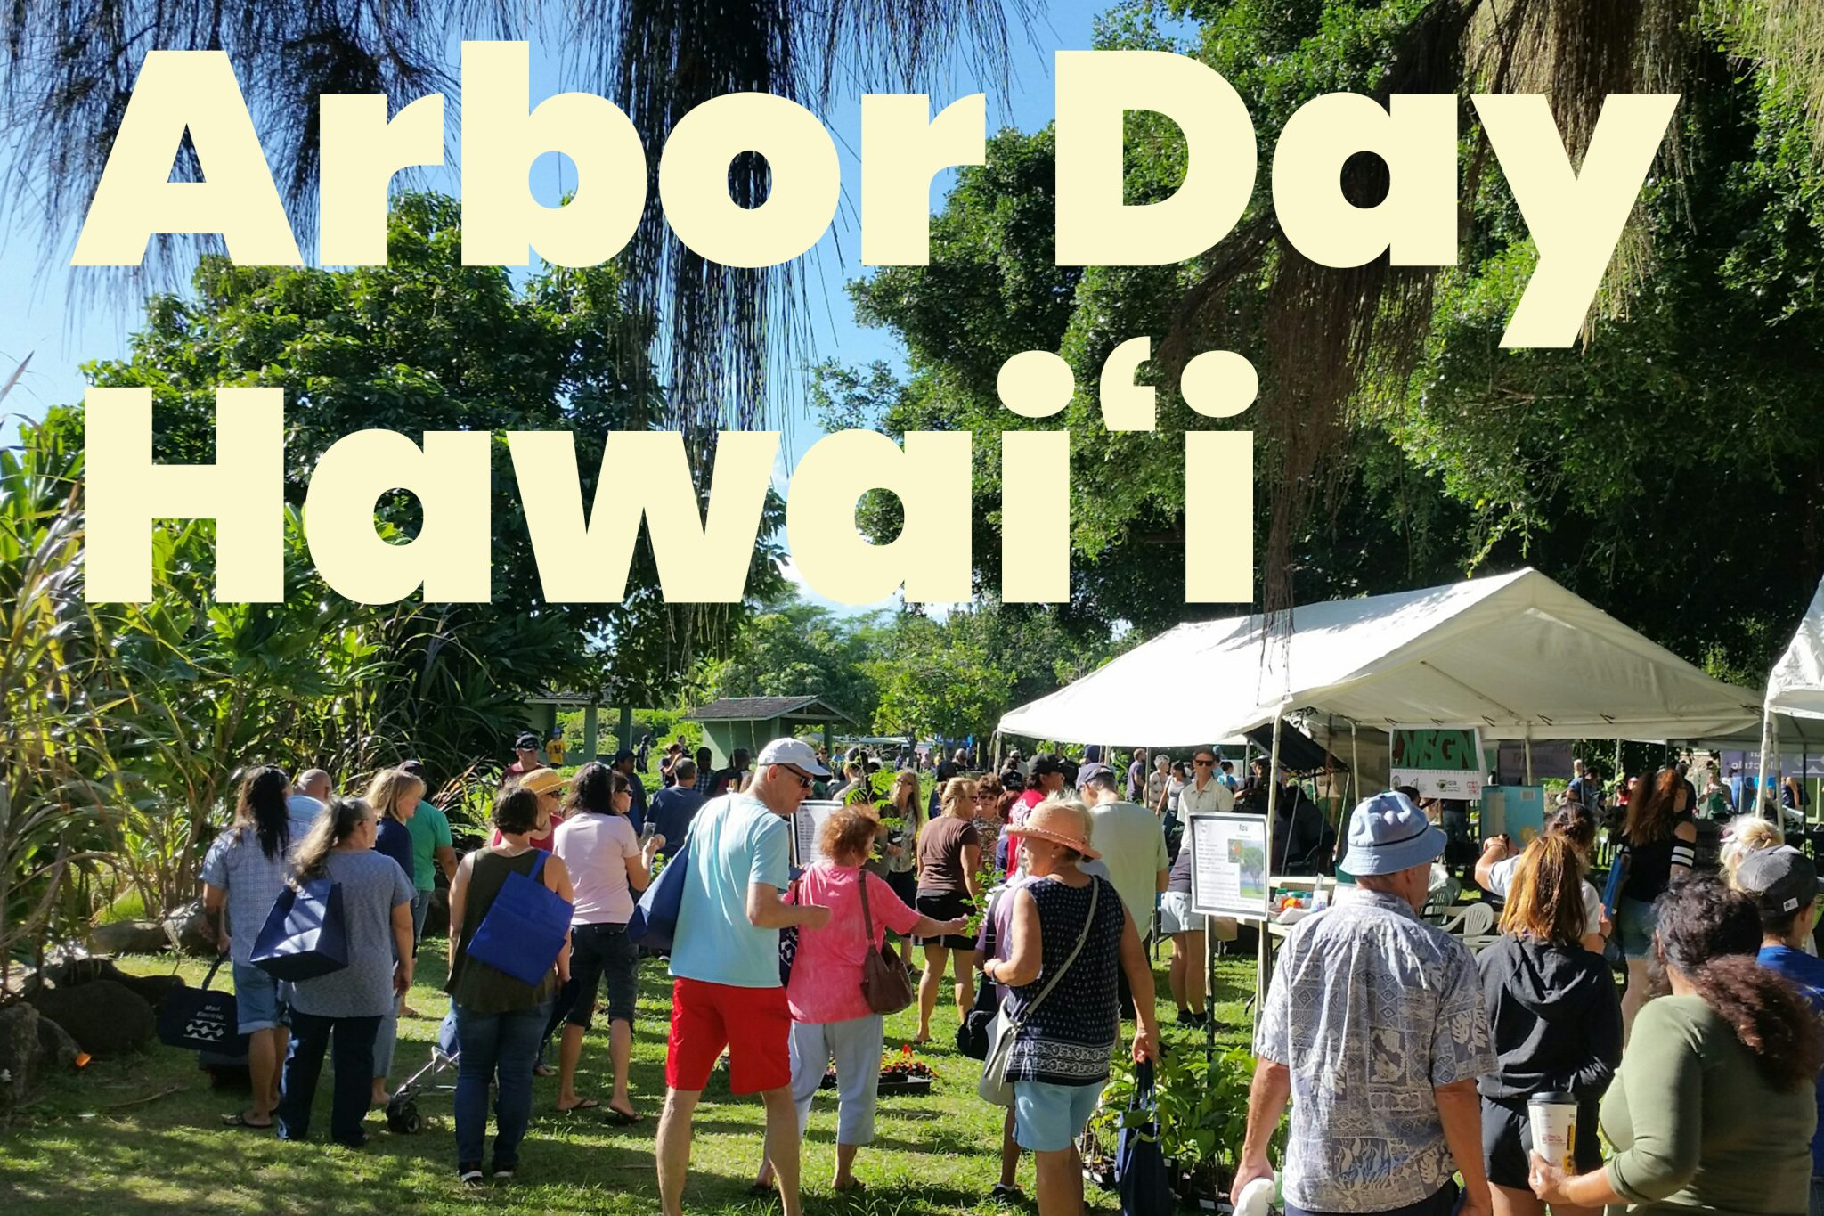
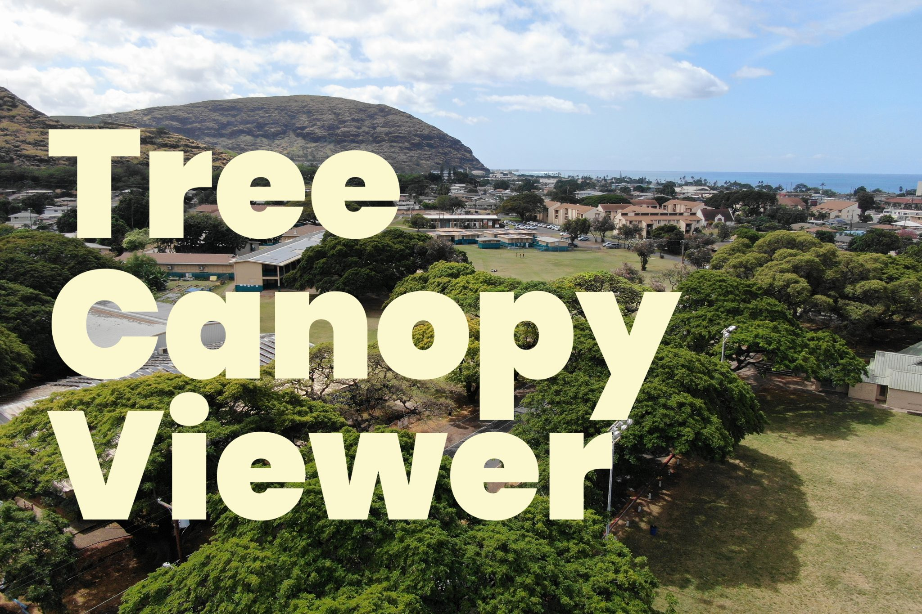
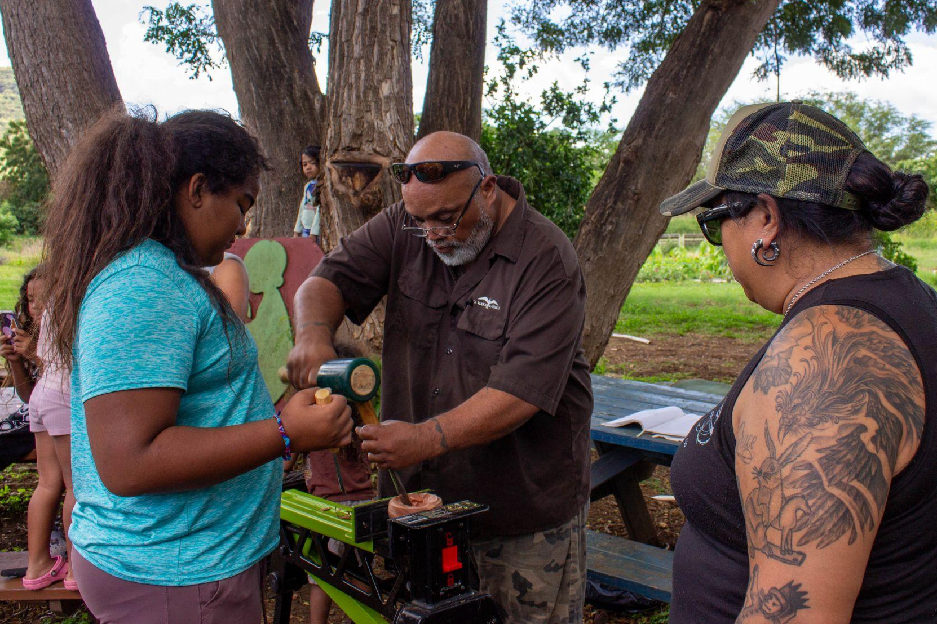
WHAT WE DO
Community Workshops
Notes:
Kaulunani is proud to be the State of Hawaii’s Urban and Community Forestry Program housed within the Department of Land and Natural Resources’ (DLNR) Division of Forestry and Wildlife.
Visit the Kaulunani program website at www.kaulunani.org.

Slide 5
TREE CITY USA
Started in 1976. For communities to manage and expand their public trees.
TREE CAMPUS HIGHER EDUCATION
Started in 2008. For colleges and universities to establish and sustain healthy community forests.
TREE CAMPUS K-12
Started in 2022. For K-12 campuses to inspire the next generation of tree stewards through experiences that bring the benefits of trees to life both inside and outside the classroom.
Notes:
Learn more about these programs and others by visiting the Arbor Day Foundation website at www.arborday.org.

Slide 6
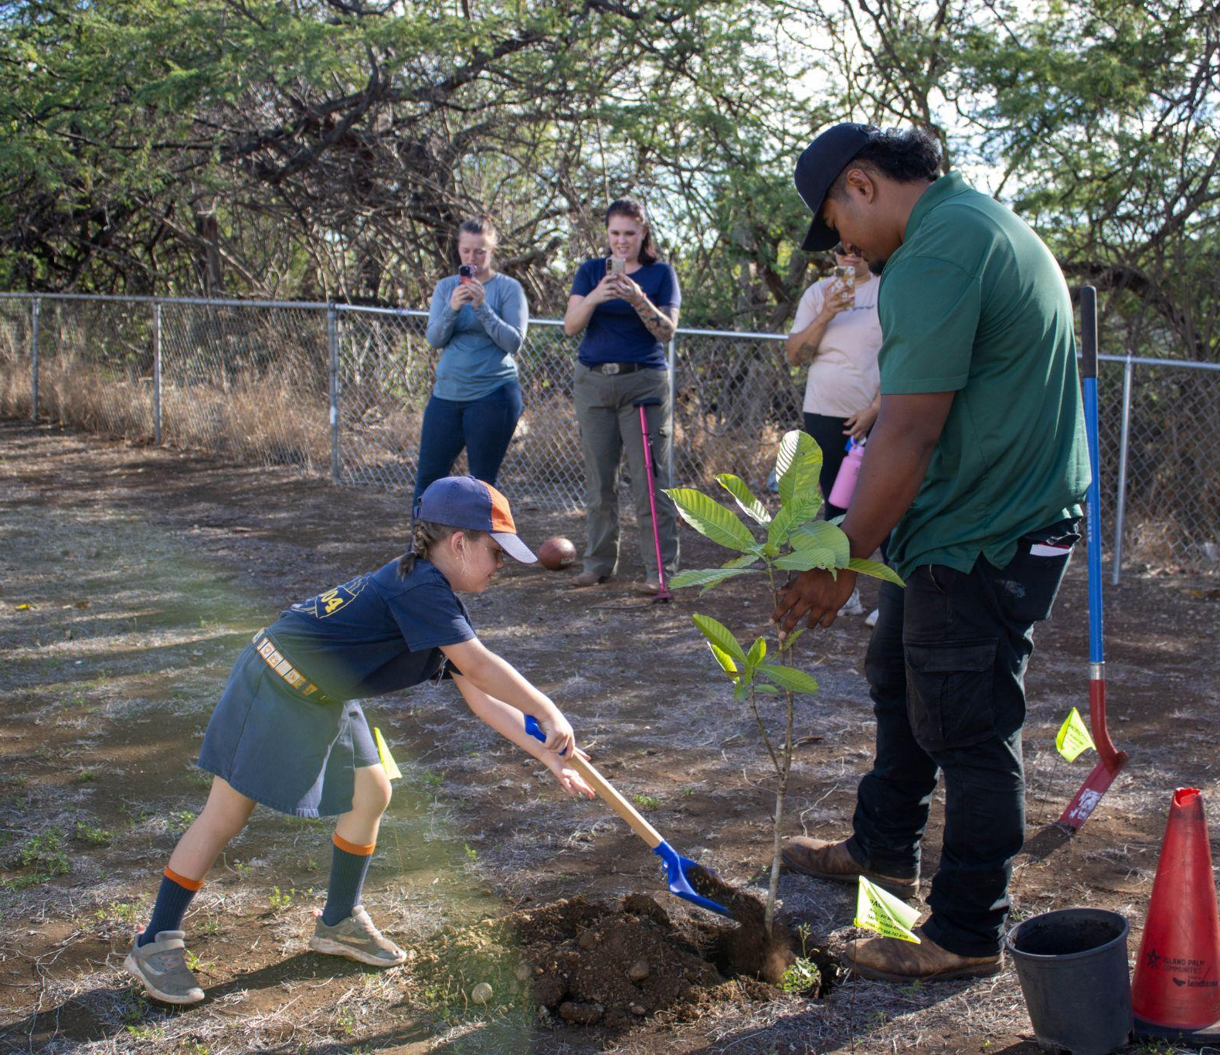
WHY BE A TREE CAMPUS?
Strengthen campus community (to trees)
Create tree-related service learning opportunities
Support campus sustainability initiatives
Grow a beautiful and green campus
Build campus pride!
All of the benefits of trees!
2023 Arbor Day celebration at Fort Shafter.
Notes:
Trees benefit our planet in many ways. When people learn about these benefits in their youth, their potential to make a positive impact on their community and world with trees becomes even greater. Here is a list of some of the benefits to becoming a tree campus!
Cultivating pilina to trees on campus, learning of their value & appreciating all of the benefits they provide
Involve campus community in caring for trees and green space.
Get help identifying partners in your community who can help bring more tree experiences to your school.
Create new pathways that connect students to service learning and community involvement.
Get to know the trees on your campus and in your community.
Create a platform for educating your school community on the benefits of trees.
Use the framework provided to bring the program to life in your school's unique way.
support campus sustainability initiatives,
show campus leadership student & faculty commitment to trees
create learning opportunities for students, show prospective students that your campus is green & beautiful & cared for.
WHY SHOULD MY SCHOOL PARTICIPATE?
A commitment to trees can significantly reduce the amount of energy your campus, and community, needs to generate.
Planting and maintaining trees absorbs carbon dioxide in the atmosphere, mitigating the effects of climate change.
Green space provides important mental health benefits to students, faculty, and staff, as well as encourages physical activity.
Involving students in tree-related service-learning projects helps educate the next generation about the importance of caring for the environment.
Recognition also builds pride among your campus and the wider community. We make it easy for you to share your designation, sending flags, press releases, logos and graphics, and other materials after your acceptance.

Slide 7
TREES HELP IMPROVE
EQUITY
FOOD SECURITY
WATER &
AIR QUALITY
CLIMATE
RESILIENCE
ECONOMY
HUMAN HEALTH
EDUCATION
COMMUNITY
SAFETY
Notes:
For more information about the benefits of trees, visit the https://dlnr.hawaii.gov/forestry/lap/kaulunani/why-trees/.
School greenspace positively impacts student performance (Kuo et al, 2018; Kuo et al, 2021)

Slide 8
2023 BY THE NUMBERS
8 communities
2 K-12 schools
2 college/universities
44,000+
trees
maintained
680+
students engaged
~370
trees planted
Notes:
Kaulunani is proud to be the State of Hawaii’s Urban and Community Forestry Program housed within the Department of Land and Natural Resources’ (DLNR) Division of Forestry and Wildlife.
Learn more about the current and past Tree City/Tree Campus recognized communities at the Kaulunani Tree Campus webpage at https://dlnr.hawaii.gov/forestry/lap/kaulunani/tree-city-usa/.

Slide 9
CLICK ON THE PROGRAM TO LEARN HOW TO APPLY.
TREE CAMPUS HIGHER ED
For colleges &
universities
TREE CAMPUS
K-12
For K-12 schools
Notes:
Kaulunani is proud to be the State of Hawaii’s Urban and Community Forestry Program housed within the Department of Land and Natural Resources’ (DLNR) Division of Forestry and Wildlife.

Slide 10
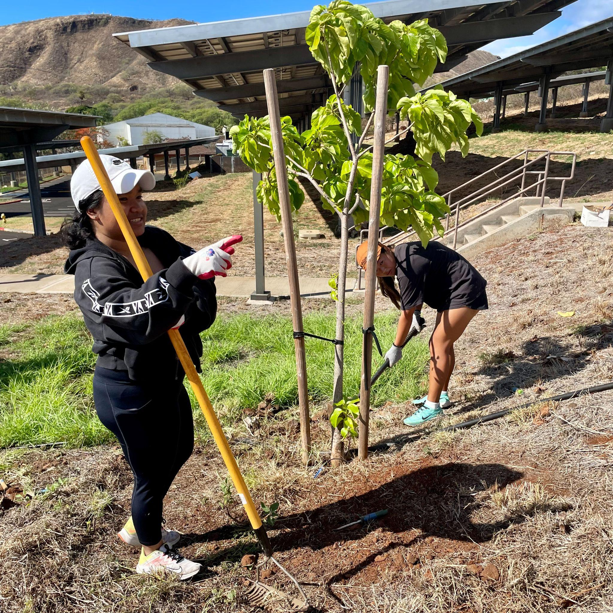
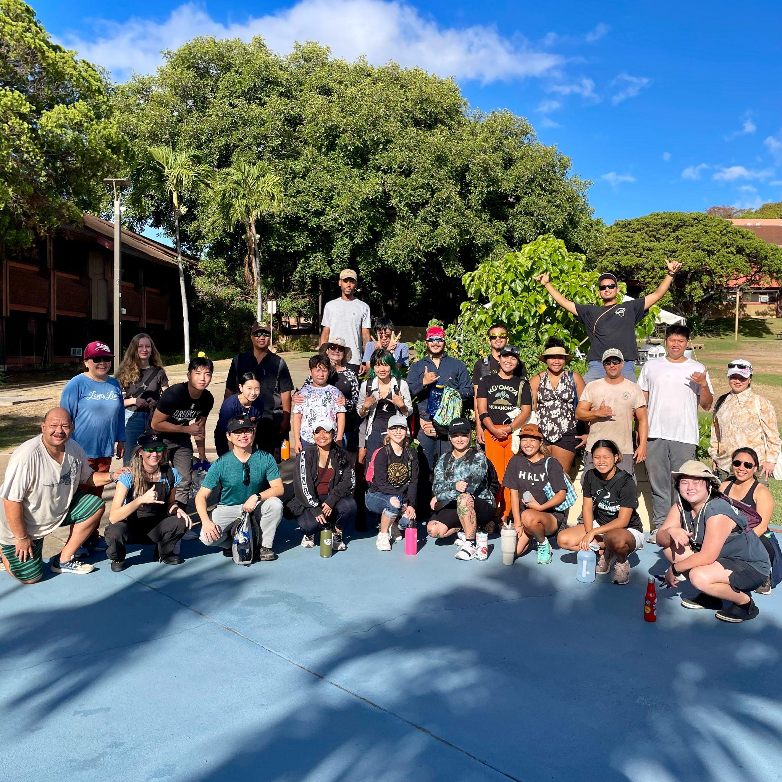
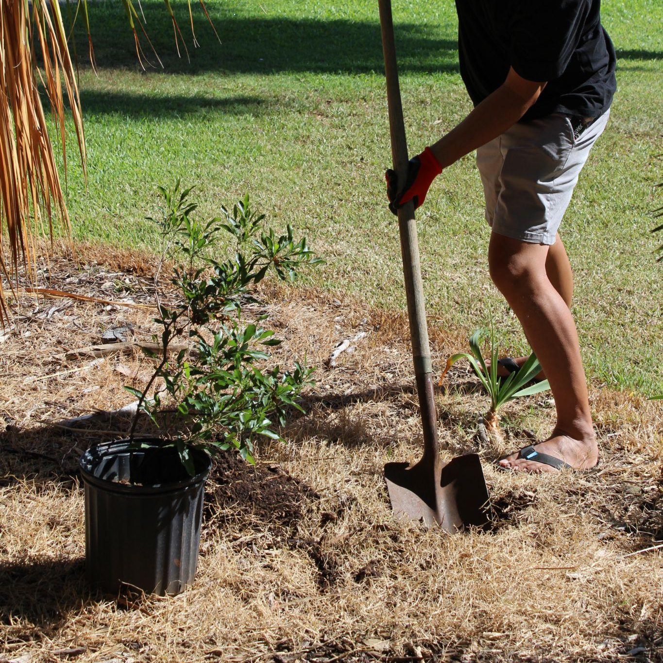
APPLYING
TREE CAMPUS HIGHER EDUCATION
2023 Arbor Day events at Kapiʻolani Community College (left and middle) and University of Hawaiʻi at Mānoa (right).
Notes:
For all college and university campuses.
Visit the Tree Campus Higher Education website for further information at https://www.arborday.org/programs/tree-campus-higher-education/

Slide 11
BACK TO PROGRAMS
LEARN MORE
APPLYING
Applications are retrospective.
Report on activities that took place in the past:
calendar year (Tree Campus Higher Ed)
academic year (Tree Campus K-12)
Apply for free through the online portal!
Reapply each year for continued participation
What you’ll need: Documentation of the program-specific standards
Notes:
Kaulunani is proud to be the State of Hawaii’s Urban and Community Forestry Program housed within the Department of Land and Natural Resources’ (DLNR) Division of Forestry and Wildlife.
Visit the Tree Campus Higher Education website for further information at https://www.arborday.org/programs/tree-campus-higher-education/

Slide 12
BACK TO PROGRAMS
LEARN MORE
PROGRAM STANDARDS
TREE CAMPUS HIGHER EDUCATION
Campus Tree Advisory Committee
Student (undergraduate or graduate)
Faculty
Facility management
Community member
Campus tree care plan
Annual expenditures
I.e. Cost of trees and maintenance, value of volunteer labor
Arbor Day Observance
Service-learning projects
Notes:
More information about the standards:
1. Campus Tree Advisory Committee represents the diverse stakeholders impacted by campus trees. The maintenance and care of campus trees is the responsibility of the campus forester, arborist, or designated staff. However, the committee can assist and provide guidance in tree planning, approval of campus tree plan, and tree-related education on campus. The committee is responsible for submitting the application. To support continuing participation in the program, think about creating a sustainable committee.
2. A Campus Tree Care Plan outlines policy and guidance for tree planting and maintenance (including trimming and removal). For more detail about what is included in a Campus Tree Care Plan, visit the program website.
3. Annual expenditures include costs associated with tree plantings and maintenance, the value of volunteer labor, trainings, and other activities associated with campus trees.
4. Be sure to document your Arbor Day Observance. The application will ask for the date of observance and an attachment documenting program activities (i.e. photos, social media posts, flyers, or news releases).
5. Service-learning projects are an opportunity to engage the campus community with the campus trees. Examples of projects include volunteer tree plantings, campus tree inventory, or assisting Project Learning Tree in training nearby school teachers or your school’s College of Education.
Visit the Tree Campus Higher Education website for further information at https://www.arborday.org/programs/tree-campus-higher-education/

Slide 13
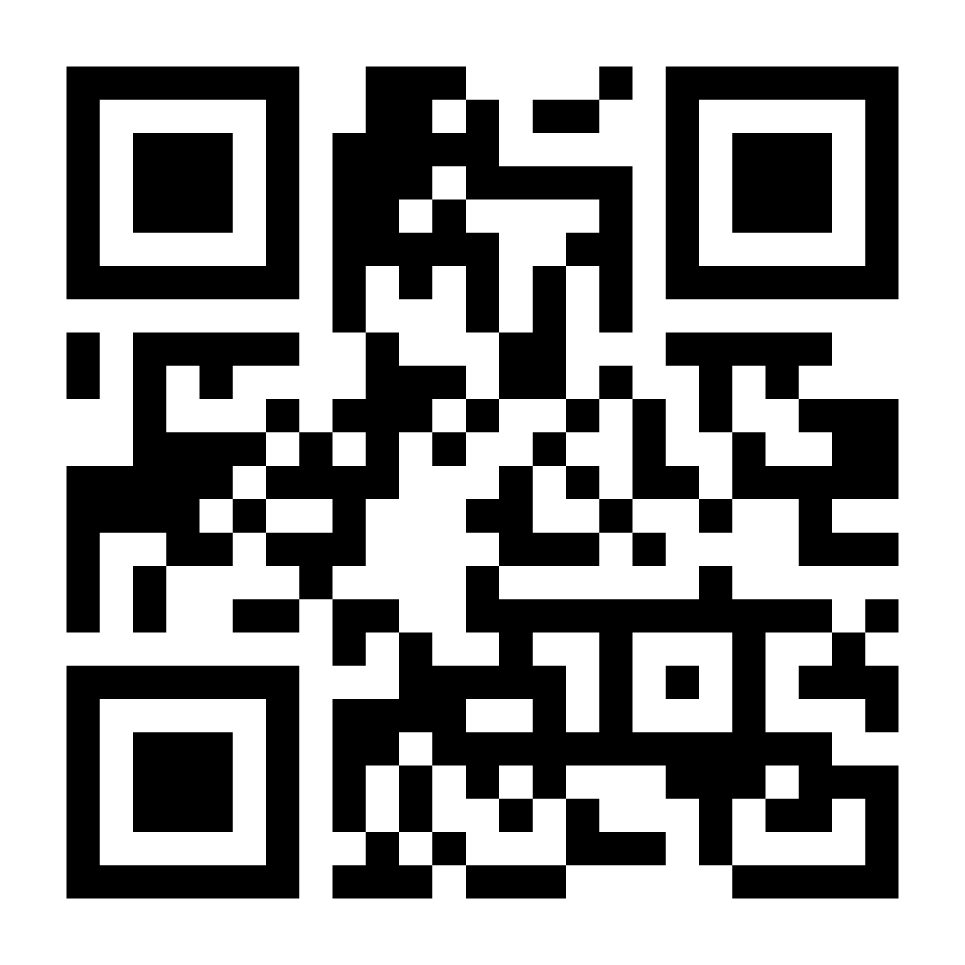
BACK TO PROGRAMS
LEARN MORE
APPLICATION
Create an account at recognition.arborday.org
Follow the prompts for each standard
Fill-in required information & upload documents
Don’t hesitate to reach out for help!
Apply online at recognition.arborday.org
Notes:
Application progress can be saved. Please be ensure any photos you upload have consent from the pictured individual or parent/guardian for use.
Visit the Tree Campus Higher Education website for further information at https://www.arborday.org/programs/tree-campus-higher-education/

Slide 14
BACK TO PROGRAMS
LEARN MORE
TIMELINE
Sept | Application Opens
Dec 31 | Deadline to Submit
Mar - Apr | Application Review State Coordinator (Kaulunani) Arbor Day Foundation
Apr 30 | Final deadline to submit revisions
May - Jun | Award Announcement
Apply online at recognition.arborday.org
Notes:
We recommend submitting applications as early as you can! That way you have ample time to review any revisions before the April 30 deadline.
State Coordinators are notified of awards via email. Recognition material is mailed to the State Coordinator by May/June, and the State Coordinator organizes delivery of material to you.
Visit the Tree Campus Higher Education website for further information at https://www.arborday.org/programs/tree-campus-higher-education/

Slide 15
BACK TO PROGRAMS
LEARN MORE
2023 TREE CAMPUS
Kapiʻolani Community College &
University of Hawaiʻi at Mānoa
2023 Arbor Day events at Kapiʻolani Community College (left and middle) and University of Hawaiʻi at Mānoa (right).
Notes:
Meet our current Tree Campus schools: Kapiʻolani Community College and University of Hawaiʻi at Mānoa.
Learn more about the current and past Tree City/Tree Campus recognized communities at the Kaulunani Tree Campus webpage at https://dlnr.hawaii.gov/forestry/lap/kaulunani/tree-city-usa/.

Slide 16
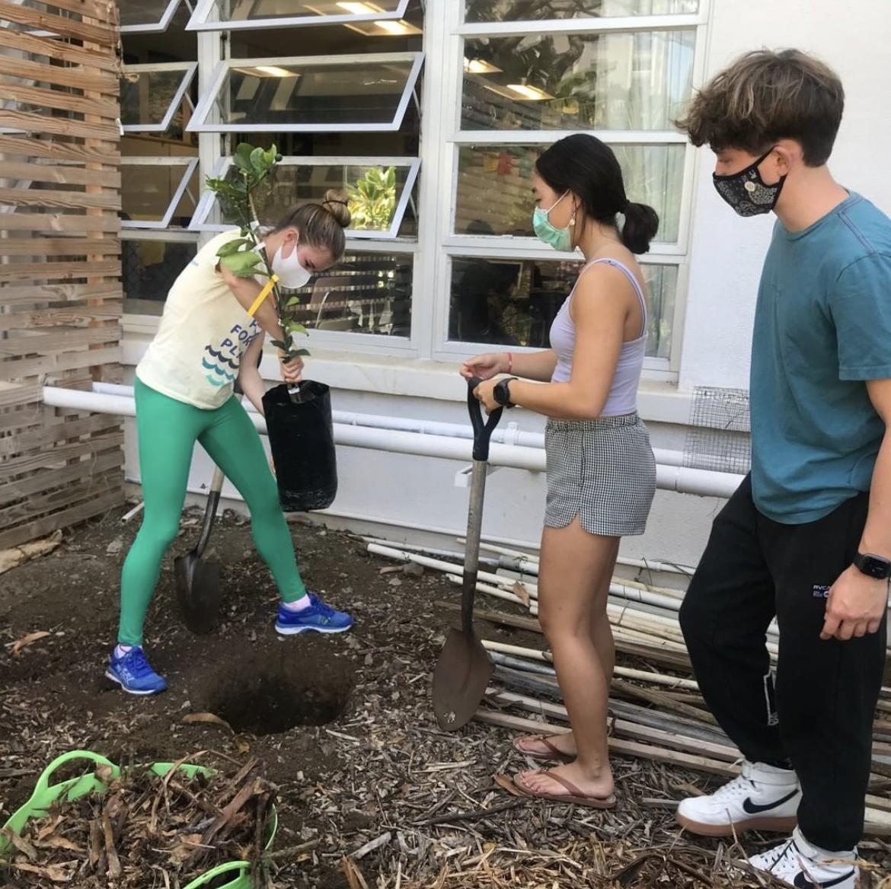
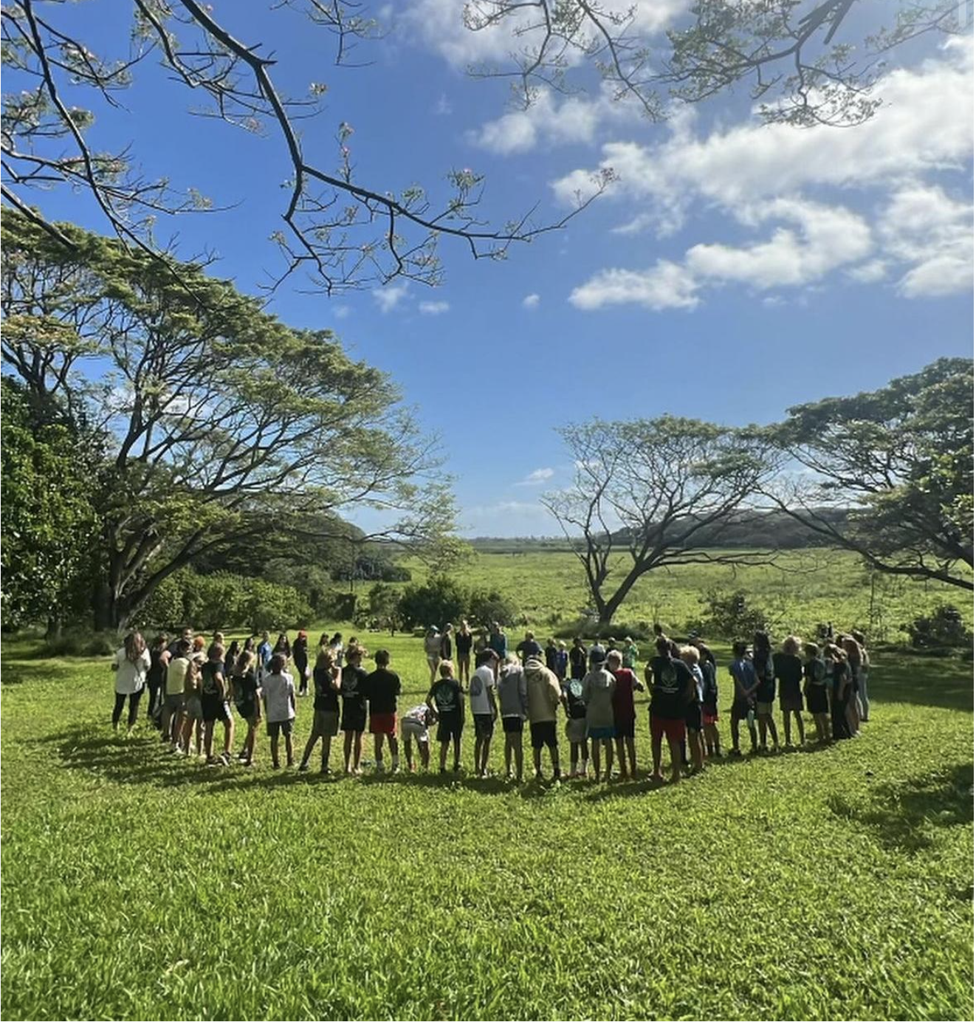
APPLYING
TREE CAMPUS K-12
Past Arbor Day events at Punahou School (left) and Le Jardin (right).
Notes:
Kaulunani is proud to be the State of Hawaii’s Urban and Community Forestry Program housed within the Department of Land and Natural Resources’ (DLNR) Division of Forestry and Wildlife.
Visit the Tree Campus K-12 program website for more information at https://www.arborday.org/programs/tree-campus-k-12/.

Slide 17
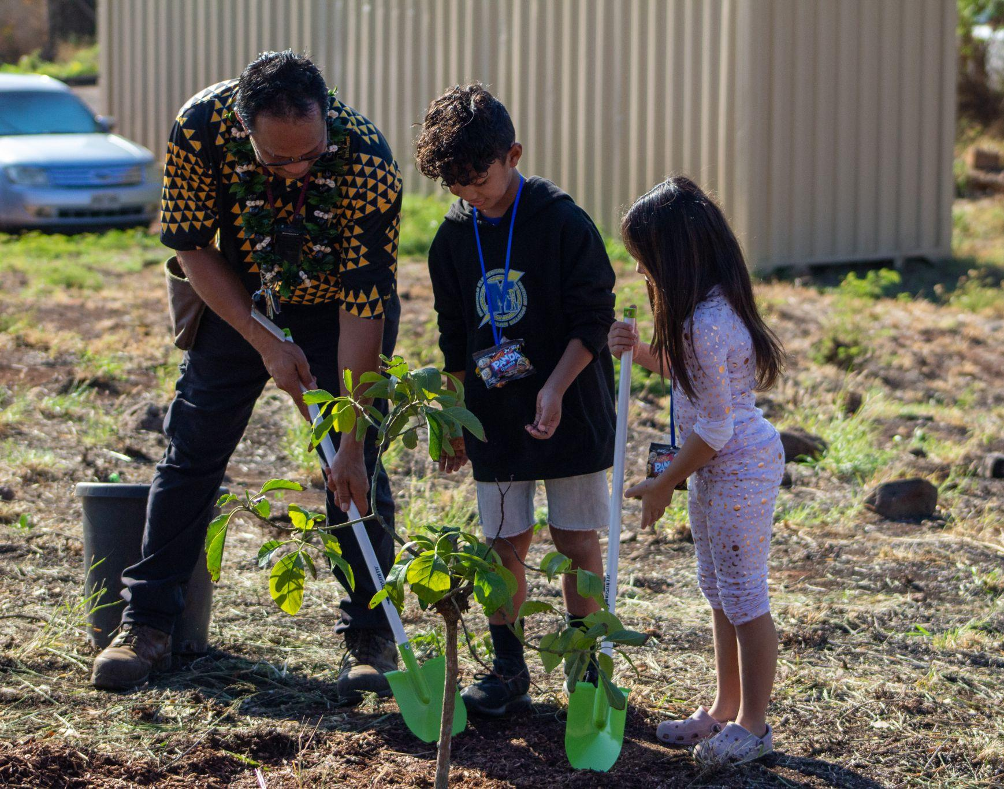
BACK TO PROGRAMS
LEARN MORE
WHO CAN APPLY?
TREE CAMPUS K-12
ALL K-12 schools!
Elementary School
Middle School
High School
Private
Public
Charter
Notes:
Kaulunani is proud to be the State of Hawaii’s Urban and Community Forestry Program housed within the Department of Land and Natural Resources’ (DLNR) Division of Forestry and Wildlife.
Visit the Tree Campus K-12 program website for more information at https://www.arborday.org/programs/tree-campus-k-12/.

Slide 18
BACK TO PROGRAMS
LEARN MORE
APPLYING
Applications are retrospective.
Report on activities that took place in the past:
calendar year (Tree Campus Higher Ed)
academic year (Tree Campus K-12)
Apply for free through the online portal!
What you’ll need: Documentation of the program-specific standards
Notes:
Kaulunani is proud to be the State of Hawaii’s Urban and Community Forestry Program housed within the Department of Land and Natural Resources’ (DLNR) Division of Forestry and Wildlife.
Visit the Tree Campus K-12 program website for more information at https://www.arborday.org/programs/tree-campus-k-12/.

Slide 19
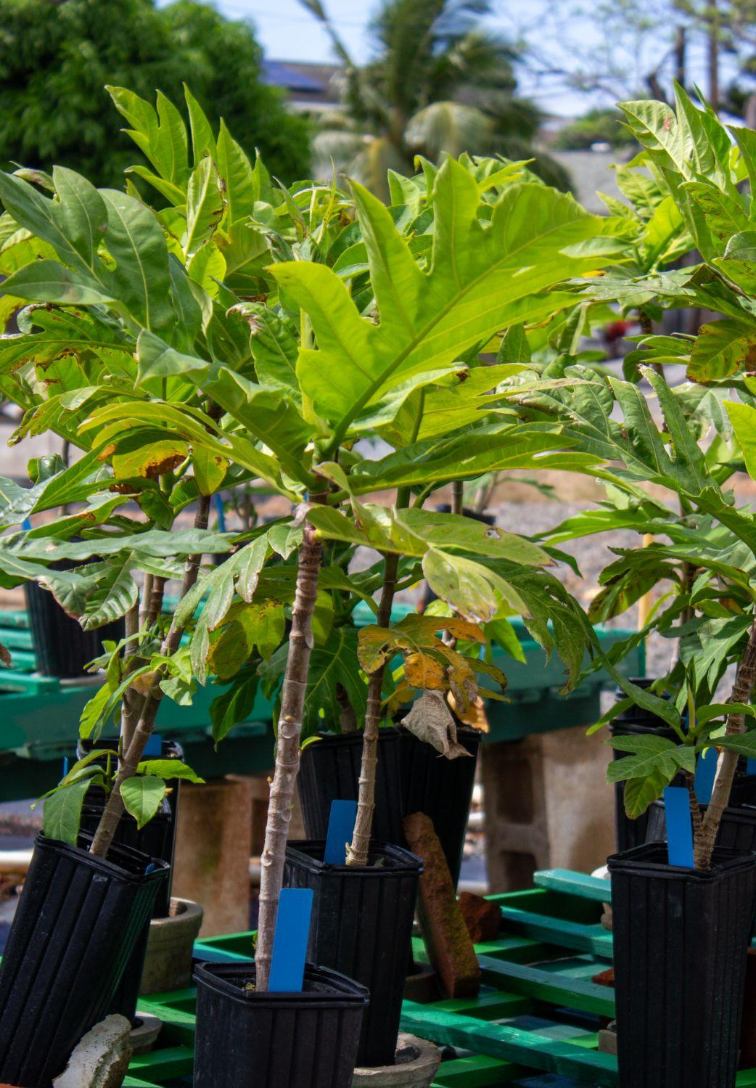
BACK TO PROGRAMS
LEARN MORE
PROGRAM GOALS
TREE CAMPUS K-12
Campus tree team
Student(s)
Teacher(s)
Staff - building & grounds, facilities maintenance crews
Education plan
Hands-on experience
Arbor Day celebration
Notes:
More information about the standards:
Tree Campus Team must include at least one student and one educator. Other community members, staff, and school organization can also join. The team regularly meets to create and organize the remaining program goals (Education Plan, Service Project, and Arbor Day Observance).
The Education Plan creates guidance for teachers, staff, or community members to facilitate tree-related education experiences for the campus. It can include experiences such as an arborist presentation, tree pruning workshop, and tree-related classroom curriculum.
Hands-on experience connects students with their campus trees. Examples include volunteer tree planting, tree inventory, or tree distribution. Keep track of the number of volunteer hours devoted by students and staff.
Be sure to document your Arbor Day Observance. The application will ask for the date of observance and an attachment documenting program activities (i.e. photos, social media posts, flyers, or news releases).
Visit the Tree Campus K-12 program website for more information at https://www.arborday.org/programs/tree-campus-k-12/.

Slide 20
BACK TO PROGRAMS
LEARN MORE
APPLICATION
Create an account at recognition.arborday.org
Follow the prompts for each standard
Fill-in boxes
Upload documents
Deadline to Submit (each year):
Jun 30: Tree Campus K-12
Application Portal recognition.arborday.org
Notes:
Application progress can be saved. Please be ensure any photos you upload have consent from the pictured individual or parent/guardian for use.
Visit the Tree Campus K-12 program website for more information at https://www.arborday.org/programs/tree-campus-k-12/.
Access the online application portal at recognition.arborday.org.

Slide 21
BACK TO PROGRAMS
LEARN MORE
TIMELINE
Tree Campus K-12
Sept | Application Opens
Jun 30 | Deadline to Submit (with revisions)
May - Jul | Application Review Arbor Day Foundation
Jul | Award Announcement
Apply online at recognition.arborday.org
LEARN MORE
Notes:
We recommend submitting applications as early as you can! That way you have ample time to review any revisions before the June 30 deadline.
State Coordinators are notified of awards via email. Recognition material is mailed to the State Coordinator by May/June, and the State Coordinator organizes delivery of material to you.
Visit the Tree Campus K-12 program website for more information at https://www.arborday.org/programs/tree-campus-k-12/.
Access the online application portal at recognition.arborday.org.

Slide 22
BACK TO PROGRAMS
LEARN MORE
2023 TREE CAMPUS
Saint Louis School & Le Jardin Academy
Saint Louis School seed propagation (left) and Earth Day/Arbor Day event at Le Jardin (right).
Notes:
Meet our current 2023 Tree Campus K-12 awardees: Saint Louis School and Le Jardin Academy.
Learn more about the current and past Tree City/Tree Campus recognized communities at the Kaulunani Tree Campus webpage at https://dlnr.hawaii.gov/forestry/lap/kaulunani/tree-city-usa/.

Slide 23
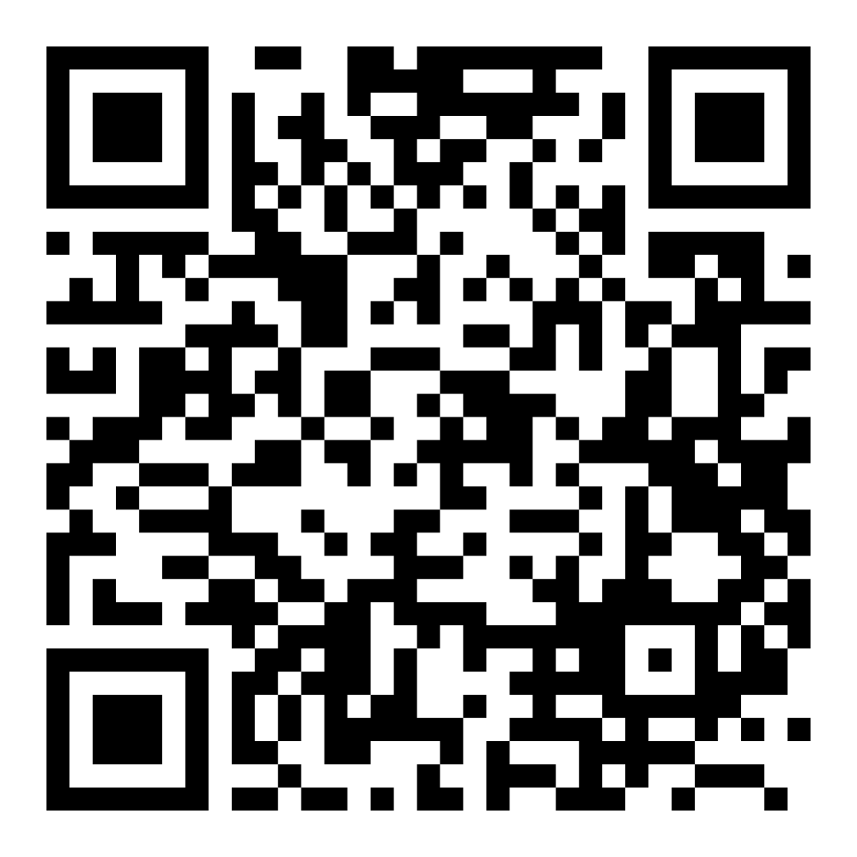
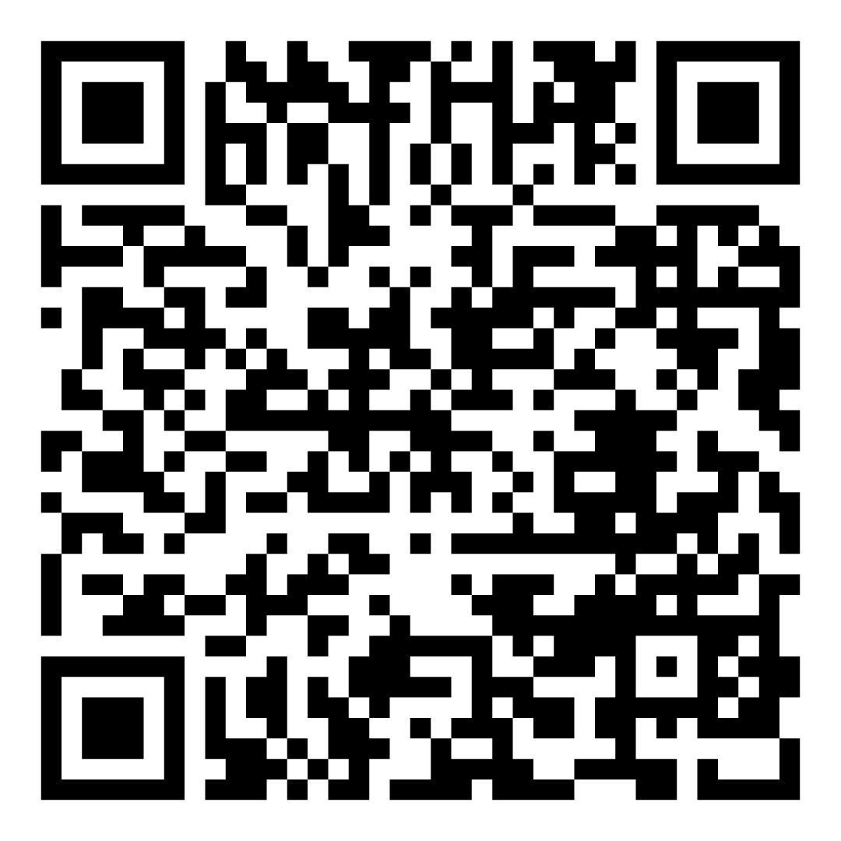
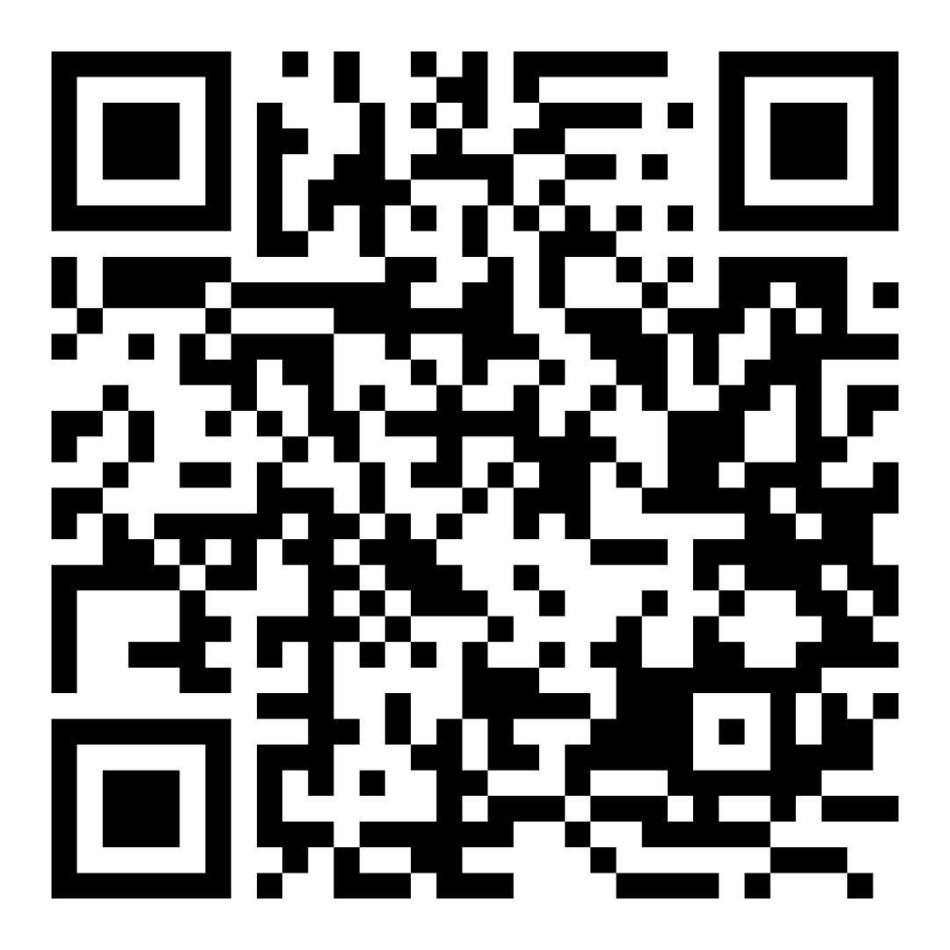
LEARN MORE
TREE CAMPUS HIGHER EDUCATION
TREE CITY USA
TREE CAMPUS K-12
Notes:
Kaulunani is proud to be the State of Hawaii’s Urban and Community Forestry Program housed within the Department of Land and Natural Resources’ (DLNR) Division of Forestry and Wildlife.
Learn more about each of the programs:
Tree City USA at www.arborday.org/programs/treecityusa/
Tree Campus Higher Education at www.arborday.org/programs/tree-campus-higher-education/
Tree Campus K-12 at www.arborday.org/programs/tree-campus-k-12/

Slide 24
STAY CONNECTED
SIGN UP FOR OUR KAULUNANI QUARTERLY NEWSLETTER
ʻUlu Bites
KAULUNANI WEBSITE
kaulunani.org
FOLLOW US ON INSTAGRAM
@kaulunani
Notes:
Kaulunani is proud to be the State of Hawaii’s Urban and Community Forestry Program housed within the Department of Land and Natural Resources’ (DLNR) Division of Forestry and Wildlife.
Visit the Kaulunani program website at www.kaulunani.org.

Slide 25
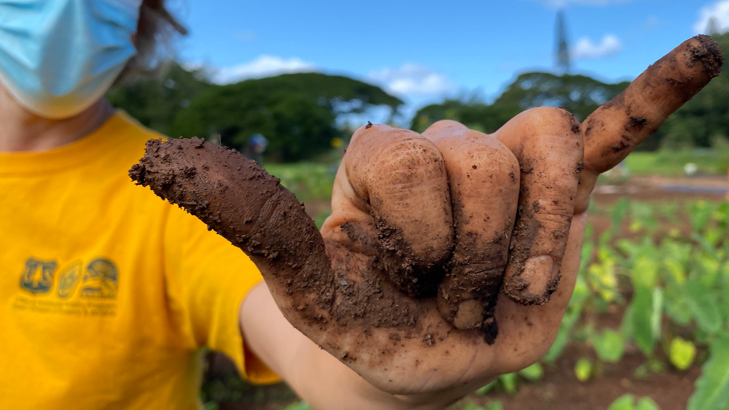
MAHALO!
CONTACT
LEʻA KAʻAHAʻĀINA State Coordinator, Kaulunani lea.a.kaahaaina.researcher@hawaii.gov | DAYNA BERRY Program Manager, Arbor Day Foundation dberry@arborday.org
Notes:
Kaulunani is proud to be the State of Hawaii’s Urban and Community Forestry Program housed within the Department of Land and Natural Resources’ (DLNR) Division of Forestry and Wildlife.
Visit the Kaulunani program website at www.kaulunani.org.

