Slide 1
Informational Briefing on DOBOR’s Non-Profit Rent Policy for 501(c)(1) & 501(c)(3) Organizations
September 8, 2023
Division of Boating and Ocean Recreation (DOBOR)

Slide 2
HRS 171-43.1 Lease to eleemosynary organizations
The board may lease, at nominal consideration, by direct negotiation and without recourse to public auction, public lands to an eleemosynary organization which has been certified to be tax exempt under sections 501(c)(1) or 501(c)(3) of the Internal Revenue Code of 1986, as amended. The lands shall be used by such eleemosynary organizations for the purposes for which their charter was issued and for which they were certified by the Internal Revenue Service. [L 1970, c83, §5; am L 1971, c 100, §1; am L 1982, c 202, §1; am L 1991, c212, §3]

Slide 3
Categorizing Non-profit Organizations
DOBOR categorizes 501(c)(1) and 501(c)(3) entities requesting revocable permits to formulate its rental recommendations to the Board of Land and Natural Resources. The four categories are as follows:
Provides a clear community benefit to the public.
Contributes to DLNR’s mission of conserving and protecting culture and/or historic resources.
Applies to statutory criteria HRS 200-20.
Benefits a specific group.
Charge membership fees
Charge for services
Community Benefit
Contributes to DLNR Mission
Statutory Criteria
HRS 200-20
Benefits a Specific Group

Slide 4
DOBOR’s Rental Policy for Non-Profit Organizations
Permittee must demonstrate a broad community involvement, further DLNR’s mission to protect and preserve Hawaiian culture, or satisfy the statutory criteria to receive the minimum allowable rent or gratis.
DOBOR’s minimum allowable rent is $40.
Staff will make its future monthly rental recommendations to the Board for non-profit revocable permit applicants on a case-by-case basis based on 4 different criteria.

Slide 5
DOBOR Non-profit Organizations

Slide 6
DOBOR Permittees
DOBOR currently has fifteen (15) revocable permits issued to non-profit 501(c)(1) and 501(c)(3) organizations.
O‘ahu
Hui Nalu O Hawaii Canoe Club
Ka Kahui Kai
Kaneohe Cultural Foundation (2)
Friends of Hokule‘a & Hawai‘iloa
Manu O Ke Kai Canoe Club
Lanikai Canoe Club
Hui Pākōlea
North Shore Canoe Club
Hawai‘i Island
The Island of Hawai‘i YMCA
Nā Kālai Wa‘a
Hoemana Canoe Club
Hawaii Big Game Fishing Club
Hawaii Island Paddlesports Association
Kona Sailing Club

Slide 7
Category 1: Provides Community Benefit

Slide 8
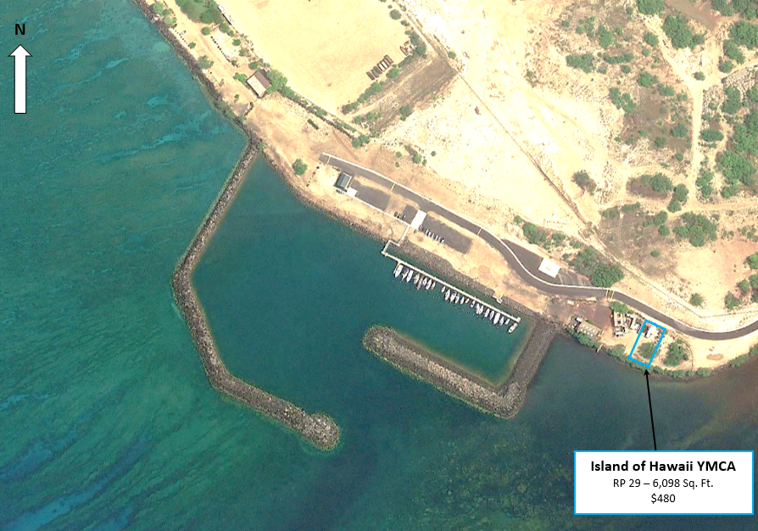
The Island of Hawai‘i YMCA
Location: South Kawaihae Small Boat Harbor, Hawai‘i Island
Usage: Sailing programs, storage purposes, marine education and youth programs.
Annual Rental: $480.00
Criteria for Rental Determination:
The YMCA’s sailing program at Kawaihae South is just one of the programs it offers to the public on Hawaii Island. The YMCA “is dedicated to providing comprehensive programs and services that enrich communities – and all of the people who live in them – across the country in fulfillment of our mission.” Considering the scope of programs and services it provides to the Hawai‘i Island community, staff believes it is eligible for the Board’s minimum allowable rent.

Slide 9
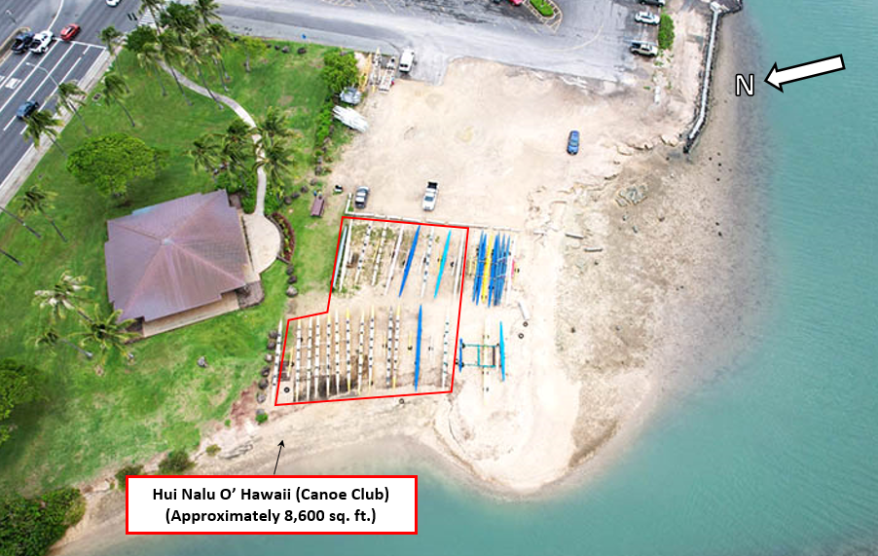
Hui Nalu O Hawaii Canoe Club
Location: Maunalua Bay, O‘ahu
Usage: Storage of Hawaiian racing canoes.
Annual Rental: $480.00
Criteria for Rental Determination:
Hui Nalu is a member of the Oahu Hawaiian Canoe Racing Association ("OHCRA"), which in turn is a member association of the Hawaiian Canoe Racing Association. Hui Nalu is therefore eligible, under HRS 200-20, to store racing canoes on State shoreline free of charge. As there is no shoreline at Maunalua Bay, the permittee requested use of fast lands at the facility. Club members serve as Hawaiian outrigger racing canoe paddling team coaches for Kaiser and Kalani High Schools. Hui Nalu also supports these teams by allowing them to use the club’s racing canoes. Hui Nalu also participates in beach clean ups and scattering the ashes of loved ones at sea for no charge. Proceeds from its Ka Iwi Coast Run & Walk support various organizations such as Livable Hawaii Kai Hui, Maunalua Fishpond Heritage Center, and the Hawaii Kai Lions Club. Due to its membership in OHCRA, and its history of community service, staff recommended the minimum allowable rent to the Board in connection with the issuance of its revocable permit.

Slide 10
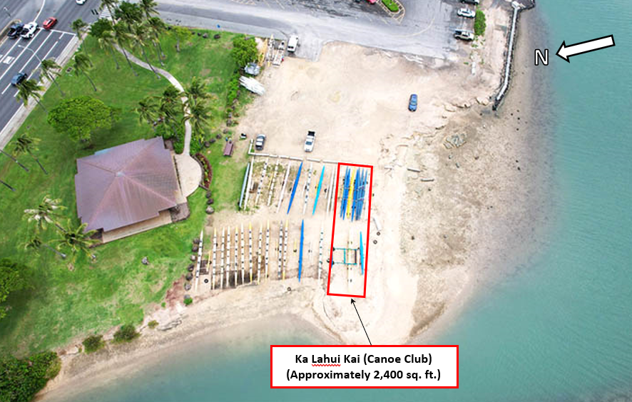
Ka Lahui Kai
Location: Maunalua Bay, O‘ahu
Usage: Storage of Hawaiian racing canoes.
Annual Rental: $480.00
Criteria for Rental Determination:
Ka Lahui Kai is a 501(c)(3) organization which applied to use State lands at Maunalua Bay. Staff recommended a market rent to the Board in connection to the issuance of its revocable permit; while the applicant argued it was eligible for the minimum allowable rent due to its community benefit (particularly ocean rescue services by club members). The Board agreed with Ka Lahui Kai and issued the RP with minimum allowable rent.

Slide 11
Category 2: Contributes to DLNR’s Mission
“Enhance, protect, conserve and manage Hawai‘i’s unique and limited natural, cultural and historic resources held in public trust for current and future generations of the people of Hawaii nei, and its visitors in partnership with others from the public and private sectors.”

Slide 12
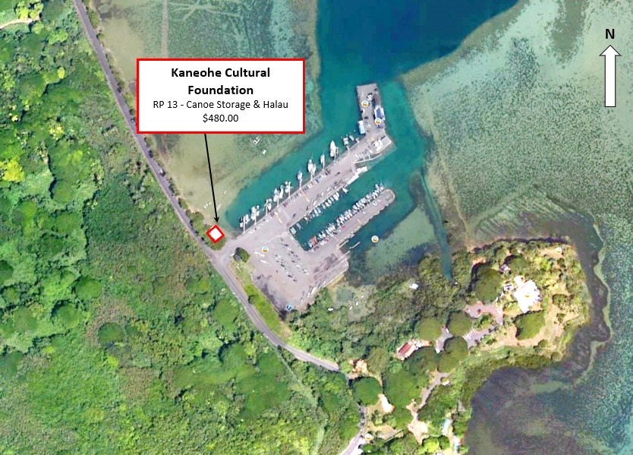
Kaneohe Cultural Foundation
Location: He‘eia-Kea Small Boat Harbor, O‘ahu
Usage: Storage of Hawaiian racing canoes on State shoreline.
Annual Rental: $480.00
Criteria for Rental Determination:
Kaneohe Cultural Foundation is a member of Hui Waʻa and is eligible, under HRS 200-20, to store racing canoes on State shoreline free of charge. The permittee stores its canoes at Heeia-Kea and is charged the minimum allowable rent because it has erected a canoe hale. In addition to the statutory basis, staff believes its mission to promote healthy living through the revitalization of Hawaiian cultural practice qualifies it to receive the Board’s minimum allowable rent.

Slide 13
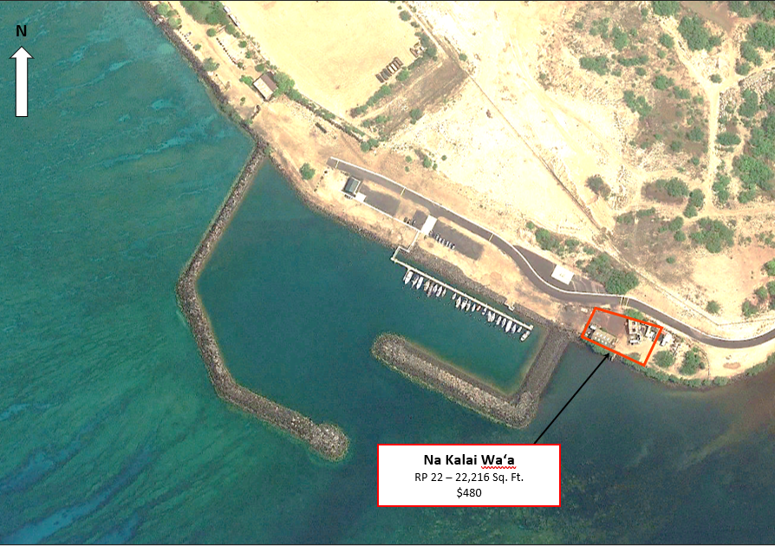
Nā Kālai Wa‘a
Location: South Kawaihae Small Boat Harbor, Hawai‘i Island
Usage: Vessel storage, general storage, maintenance of improvements, youth programs, educational programs, and affiliated community programs.
Annual Rental: $480.00
Criteria for Rental Determination:
Nā Kālai Waʻa is an educational based 501(c)(3) organization dedicated to the cultural values, knowledge and practices of deep-sea voyaging utilizing the double-hull sailing canoe Makaliʻi. Its mission is “to protect, perpetuate and honor the indigenous Hawaiian traditions and practices of waʻa culture through the Makaliʻi voyaging canoe programs, for the past, present and future generations.” Staff believes this mission, which is in furtherance of DLNR’s mission to protect cultural resources, is deserving of the Board’s minimum monthly rent.

Slide 14
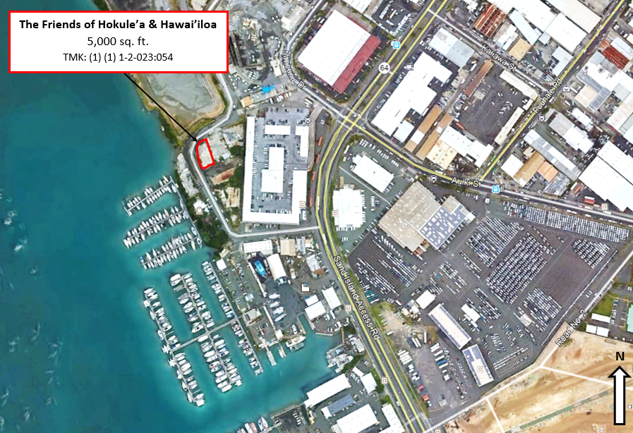
Friends of Hokule‘a & Hawai‘iloa
Location: Ke‘ehi Small Boat Harbor, O‘ahu
Usage: Teaching traditions of building, restoring, and caring for canoes.
Annual Rental: $480.00
Criteria for Rental Determination:
Friends of Hokuleʻa and Hawaiʻiloa is a 501(c)(3) organization dedicated to the perpetuation of the values and skills of traditional Hawaiian canoe building as well as the cultural and religious setting in which the canoes were built. Following the permittee's application to use State lands, staff recommended the minimum allowable rent because of the organization's cultural mission, which furthers DLNR’s mission to protect cultural resources, and the Board agreed.

Slide 15
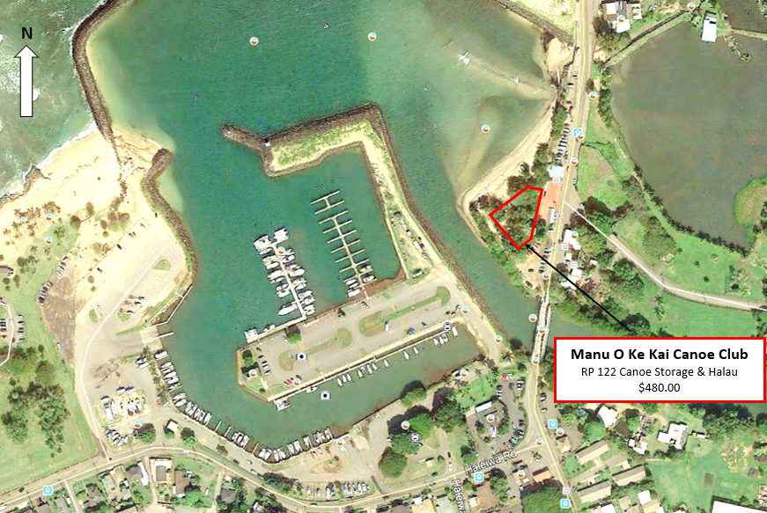
Manu O Ke Kai Canoe Club
Location: Haleiwa Small Boat Harbor, O‘ahu
Usage: Storage of canoes.
Annual Rental: $480.00
Criteria for Rental Determination:
One of Manu O Ke Kai’s purposes is to perpetuate Hawaiian culture through the promotion of Hawaiian watersports. It is a member of Hui Waʻa and eligible, under HRS 200-20, to store racing canoes on State shoreline free of charge. Since the shoreline in this area recedes and accumulates, depending on the season, it is impossible for Manu O Ke Kai to store its canoes there year-around. The permittee requested the use of State lands for the storage of canoes and for cultural practices. In addition to the statutory basis, staff believes its purpose furthers DLNR’s mission to protect cultural resources and qualifies it to receive the Board’s minimum allowable rent.

Slide 16
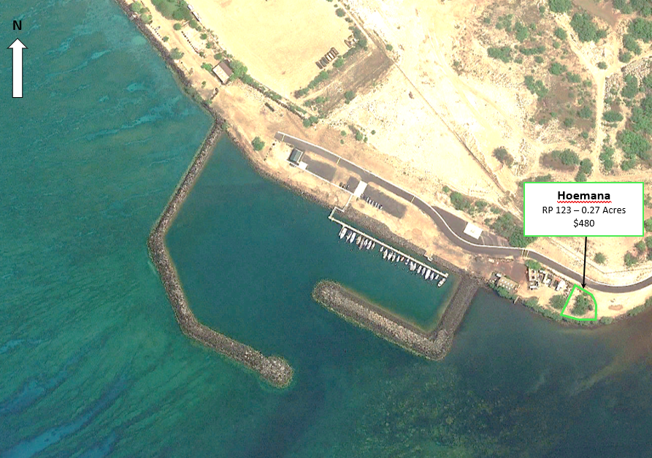
Hoemana Canoe Club
Location: South Kawaihae Small Boat Harbor, Hawai‘i Island
Usage: Storage of canoes.
Annual Rental: $480.00
Criteria for Rental Determination:
Member of Moku ʻO Hawaii, which is a member association of the Hawaiian Canoe Racing Association. Hoemana is eligible, under HRS 200-20, to store racing canoes on State shoreline free of charge. Because there is no shoreline at Kawaihae South, the permittee requested use of fast lands at the harbor. Hoemana is dedicated to reviving Hawaiian historical perspectives and cultural protocols related to paddling and outrigger canoes and aligns with DLNR’s mission to protecting cultural resources. As a result, staff recommended the Board grant the minimum allowable rent in connection with the issuance of its revocable permit.

Slide 17
Category 3: Statutory Criteria HRS 200-21

Slide 18
HRS 200-21 Hawaiian Outrigger Canoes On State Shoreline
Hawaiian outrigger canoe clubs registered with the Hawaiian Canoe Racing Association, Hui Wa‘a Association, its affiliates, or its successor organization may keep their Hawaiian outrigger canoes at no charge on state shoreline areas; provided that:
The club shall indemnify, hold harmless, and defend the State, its officers, agents, and employees from and against any and all claims arising out of or resulting from activities carried out or undertaken under this section, and shall procure sufficient insurance to provide this indemnification if requested by the department;
The club shall coordinate the placement of canoes with the applicable state or county authority to appropriately accommodate all beach users; and
Where required, the club shall secure an annual revocable permit from the applicable state or county agency. [L 2005, c 220, §2]

Slide 19
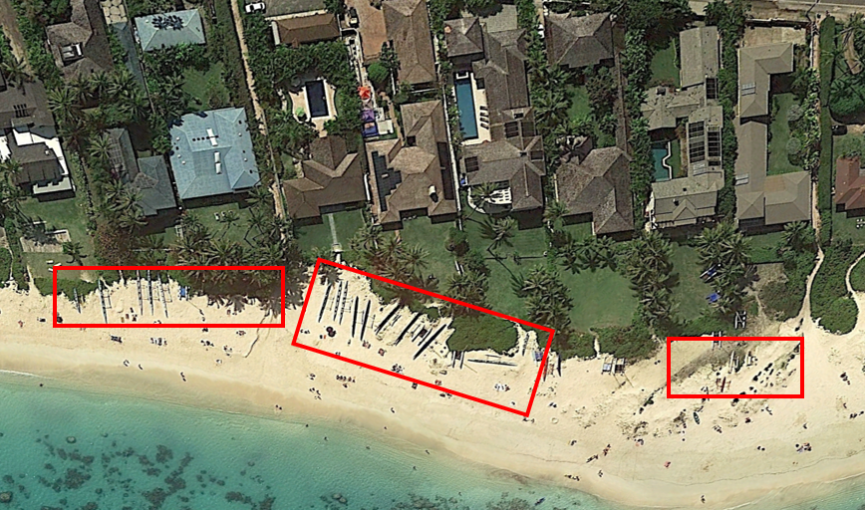
Lanikai Canoe Club
Location: Kailua, O‘ahu
Usage: Storage of Hawaiian racing canoes on State shoreline.
Annual Rental: $0.00
Criteria for Rental Determination:
Lanikai Canoe Club ("Lanikai") is a member of the Oahu Hawaiian Canoe Racing Association ("OHCRA"), which in turn is a member of the Hawaiian Canoe Racing Association. Lanikai is eligible, under HRS 200-20, to store racing canoes on State shoreline free of charge.
Lanikai Canoe Club RP 135 – 8,800 sq. ft.

Slide 20
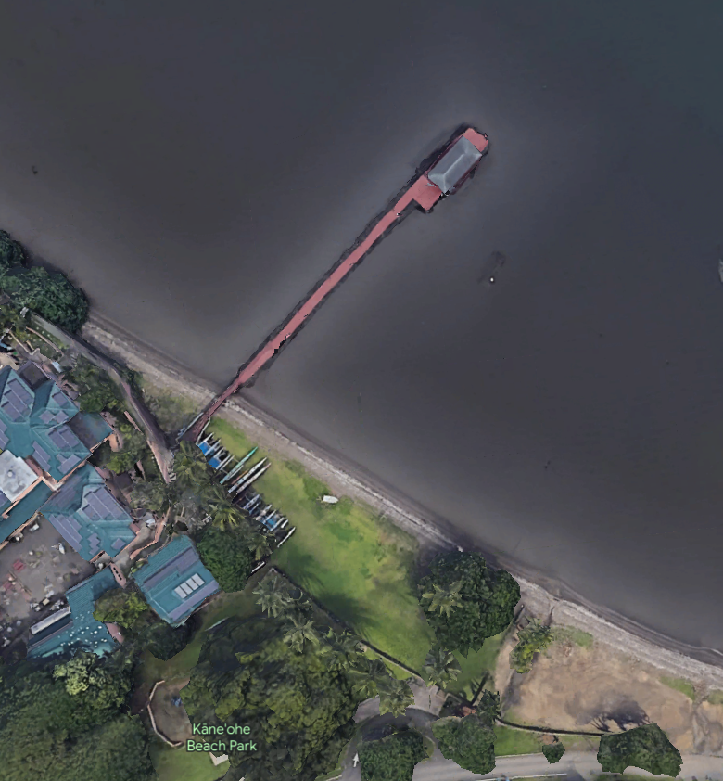
Kaneohe Cultural Foundation
Location: Kaneohe Beach Park, O‘ahu
Usage: Storage of Hawaiian racing canoes on State shoreline.
Annual Rental: $0.00
Criteria for Rental Determination:
Kaneohe Cultural Foundation is a member of Hui Waʻa and eligible, under HRS 200-20, to store racing canoes on State shoreline free of charge.
Kaneohe Cultural Foundation

Slide 21
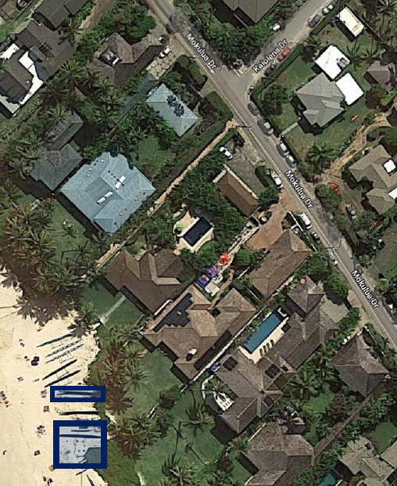
Hui Pākōlea
Location: Kailua, O‘ahu
Usage: Storage of Hawaiian racing canoes on State shoreline.
Annual Rental: $0.00
Criteria for Rental Determination:
Hui Pākōlea is a 501(c)(3) organization whose mission is to preserve Hawaiian culture by, among other things, teaching, preserving, and supporting traditional Hawaiian events, activities, practices, and language, and to build a better community by providing opportunities for participation in and learning about traditional Hawaiian events, activities, practices and language. As an honorary member of the Hawaiʻi Canoe Racing Association, Hui Pākōlea is eligible under HRS 200-20 to store its canoes on State shoreline free of charge.
Hui Pakolea
RP 101 - 2,275 sq. ft.

Slide 22
Category 4: Benefits A Specific Group

Slide 23
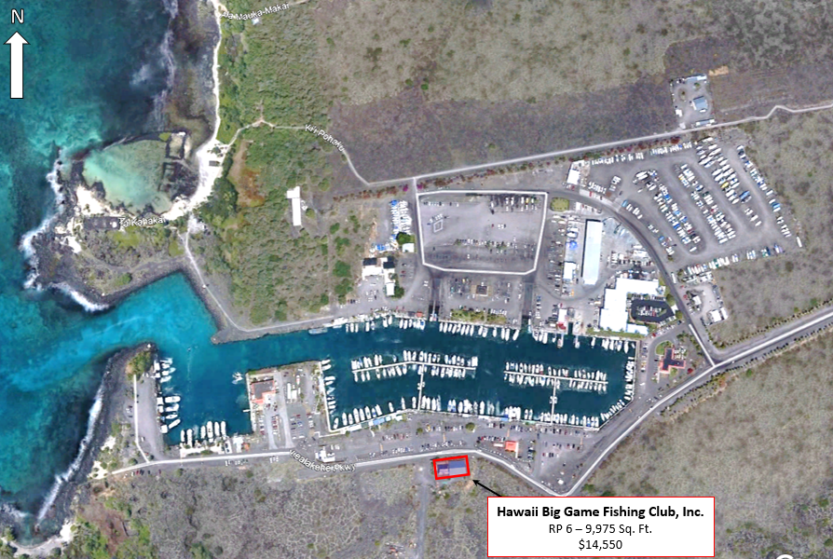
Hawai‘i Big Game Fishing Club, Inc.
Location: Honokohau Small Boat Harbor, Hawai‘i Island
Usage: Fishing and boating activities, public meetings, tournaments, harbor meetings and continued support of youth groups.
Annual Rental: $14,550.00
Criteria for Rental Determination:
Hawaiʻi Big Game Fishing Club, Inc. is a 501(c)(3) organization formed for the preservation and conservation of marine resources through public education, research, the promotion of sportsmanship among the youth of the community & through participation in club activities. The club’s funding is derived from renting out its clubhouse on a limited basis to various community organizations, collecting fees from its members and entrance fees from the several fishing tournaments it organizes each year. Staff believes that its charitable activities benefit a narrow group of individuals and not the general public. It is for this reason that staff recommends charging Hawaii Big Game Fishing Club, Inc. a market rent.

Slide 24
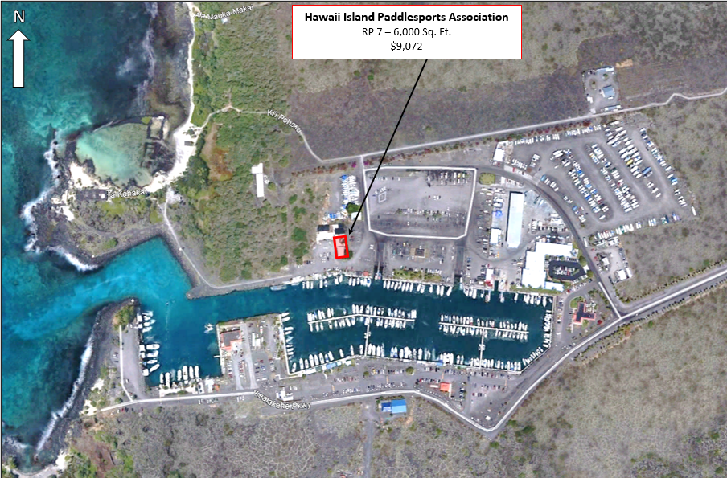
Hawai‘i Island Paddlesports Association
Location: Honokohau Small Boat Harbor, Hawai‘i Island
Usage: Operate and maintain a Hawaiian style hālau for permittees meetings, storage of solo or duo canoes, kayaks, general equipment, and staging area for preparation of race events.
Annual Rental: $9,072.00
Criteria for Rental Determination:
Hawaiʻi Island Paddlesports Association (“HIPA”) organizes and conducts all competitive OC-1 and OC-2 races as well as other paddle sport events and championships on Hawaii Island. HIPA also sponsor and administers a junior paddlers program. It uses its space at Honokohau Small Boat Harbor for club meetings, staging and preparation of race events, storage its members OC-1, OC-2 canoes, kayaks and general equipment. Staff views the permittees activities as benefiting a small segment of the public, and therefore not eligible for the Board’s minimum rent.

Slide 25
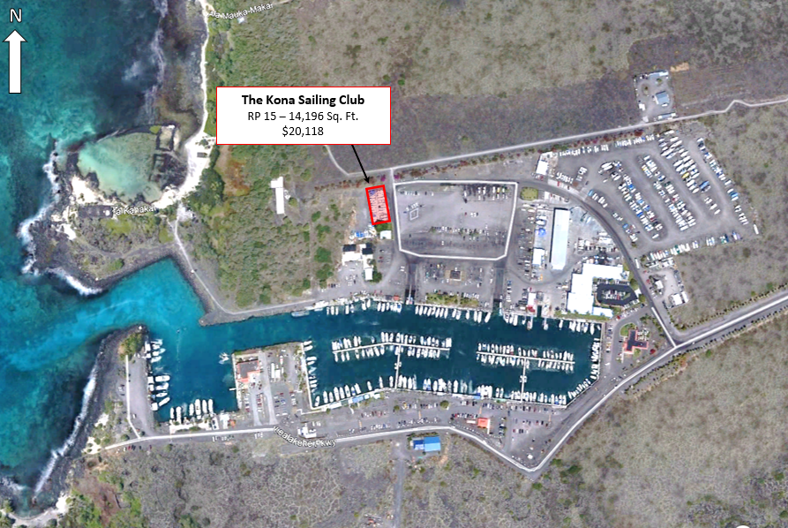
Kona Sailing Club
Location: Honokohau Small Boat Harbor, Hawai‘i Island
Usage: Trailered boat storage, sailing related equipment, storage, and boating and ocean safety education and training activities.
Annual Rental: $20,118.00
Criteria for Rental Determination:
Kona Sailing Club is a 501(c)(3) organization established “by and for sailors who actually get out on the water.” Its purpose is to host numerous sailing and social events throughout the year, and boat storage. As such staff views it as an organization existing primarily for the benefit of its members and the sailing community with no broad community benefit.

Slide 26
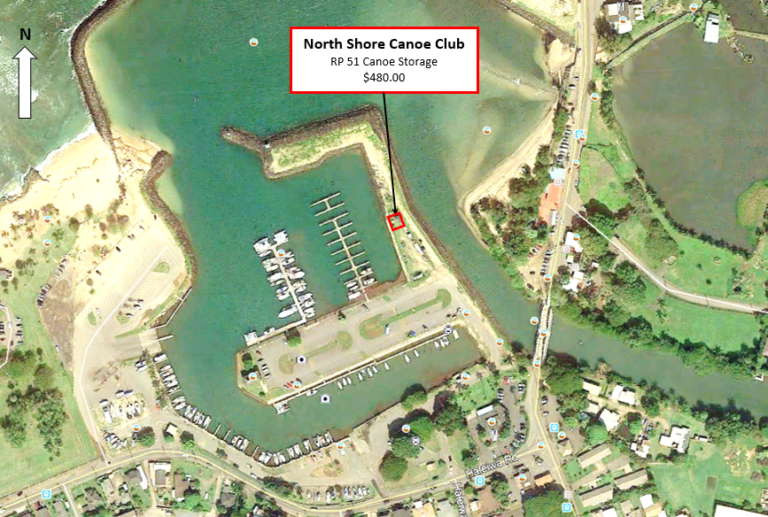
North Shore Canoe Club
Location: Haleiwa Small Boat Harbor, O‘ahu
Usage: Canoe storage and trailer parking.
Current Annual Rental: $480.00
North Shore Canoe Club (“NSCC”) is a member of Hui Waʻa through its trade name, Haleiwa Outrigger Canoe Club. NSCC stores its canoes at Haleiwa Beach Park and its trailer at the harbor.
DOBOR’s Administrative Rules (HAR §13-234-12) allow harbor staff to issue a permit for trailer storage for $100/month. Staff believes this is the more appropriate disposition and will cancel the revocable permit and instruct the harbor staff issue the trailer permit in its place.

